Slide 1
Threat Model Analysis
Charles Wilson
Staff Product Cybersecurity Architect
version 2
2025-06-06
Notes:
Script:
I'm Charles Wilson, Staff Product Cybersecurity Architect at Torc Robotics.
This presentation will cover an overview of threat model analysis.

Slide 2
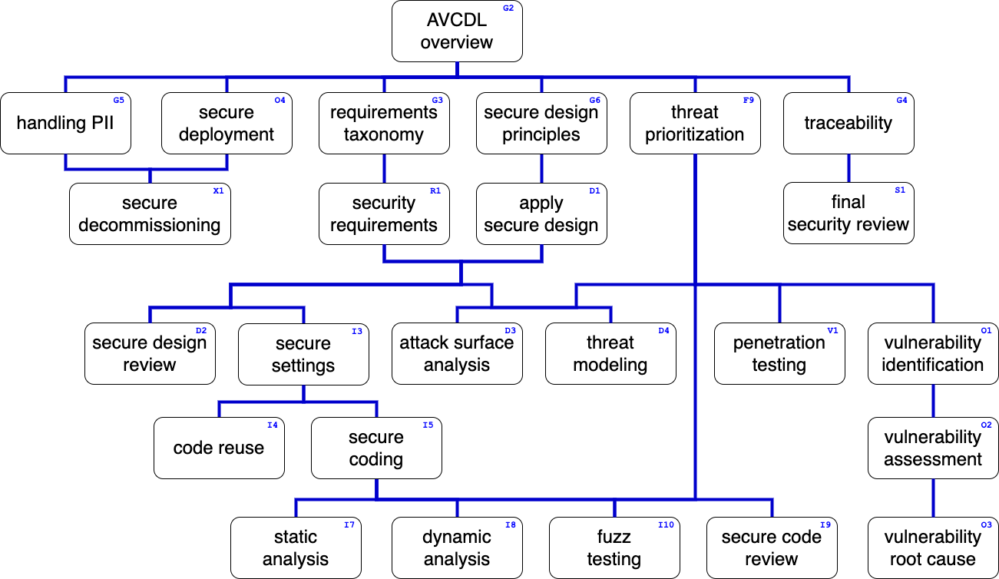
Training Path
Notes:
Script:
This diagram shows the overall AVCDL training path.
If you're taking this training, it's assumed that you've already completed the AVCDL overview training,
and additionally, that you've completed the
requirements taxonomy
security requirements
secure design principles
apply secure design
and
threat prioritization plan training.
Additionally, you should have completed the threat modeling overview and model creation trainings.
This training will cover threat model analysis.

Slide 3
Introduction
Notes:
Script:
Before getting into threat model analysis, let's briefly review where it fits in the overall threat modeling process.

Slide 4
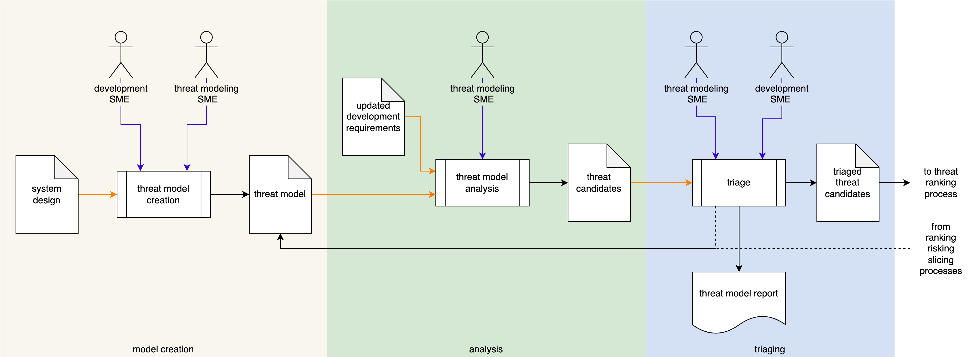
Threat Modeling Process
Notes:
Script:
Here’s the threat modeling process with its three individual activities,
model creation
model analysis
and
threat candidate triage
Let’s consider the model analysis activity.

Slide 5
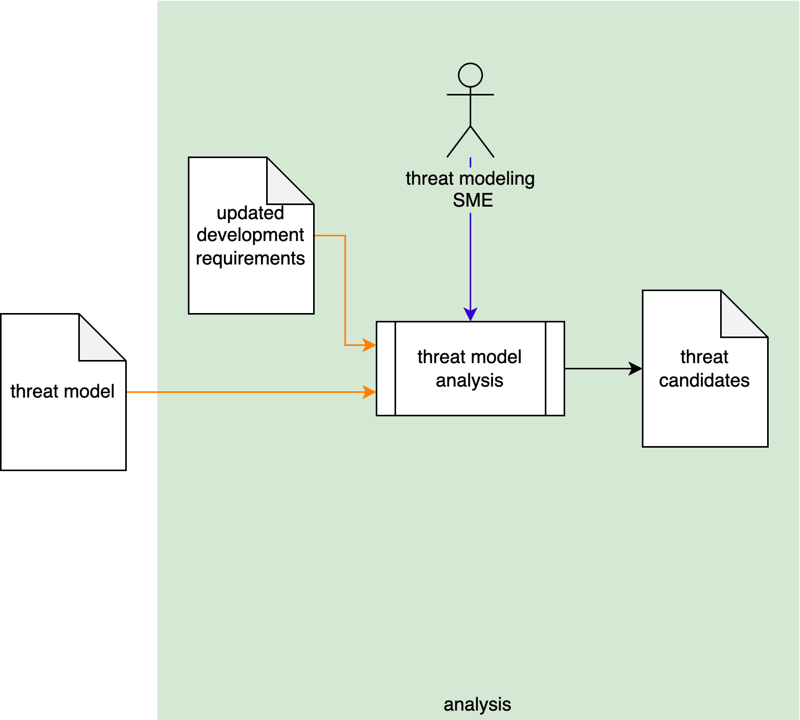
Model Analysis Activity
Notes:
Script:
In the threat model analysis activity,
[pause]
The threat modeling SME
[pause]
takes the threat model
[pause]
and updated development requirements
[pause]
and performs an analysis which results in the creation of
[pause]
a set of threat candidates.
[break]
Returning to the NIST threat modeling lifecycle, we see that threat model analysis corresponds to
[pause]
the identification activity of the lifecycle.

Slide 6
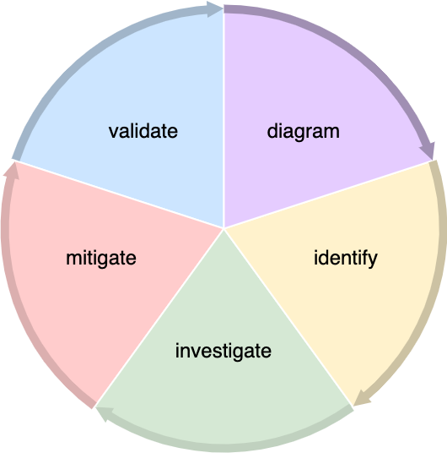
Model Analysis Activity
Notes:
Script:
In the threat model analysis activity,
[pause]
The threat modeling SME
[pause]
takes the threat model
[pause]
and performs an analysis which results in the creation of
[pause]
a set of threat candidates.
[break]
Returning to the NIST threat modeling lifecycle, we see that threat model analysis corresponds to
[pause]
the identification activity of the lifecycle.

Slide 7
Example
Notes:
Script:
Now let's work our way through the same example used in threat model creation to illustrate how the threat modeling analysis activity is undertaken.

Slide 8
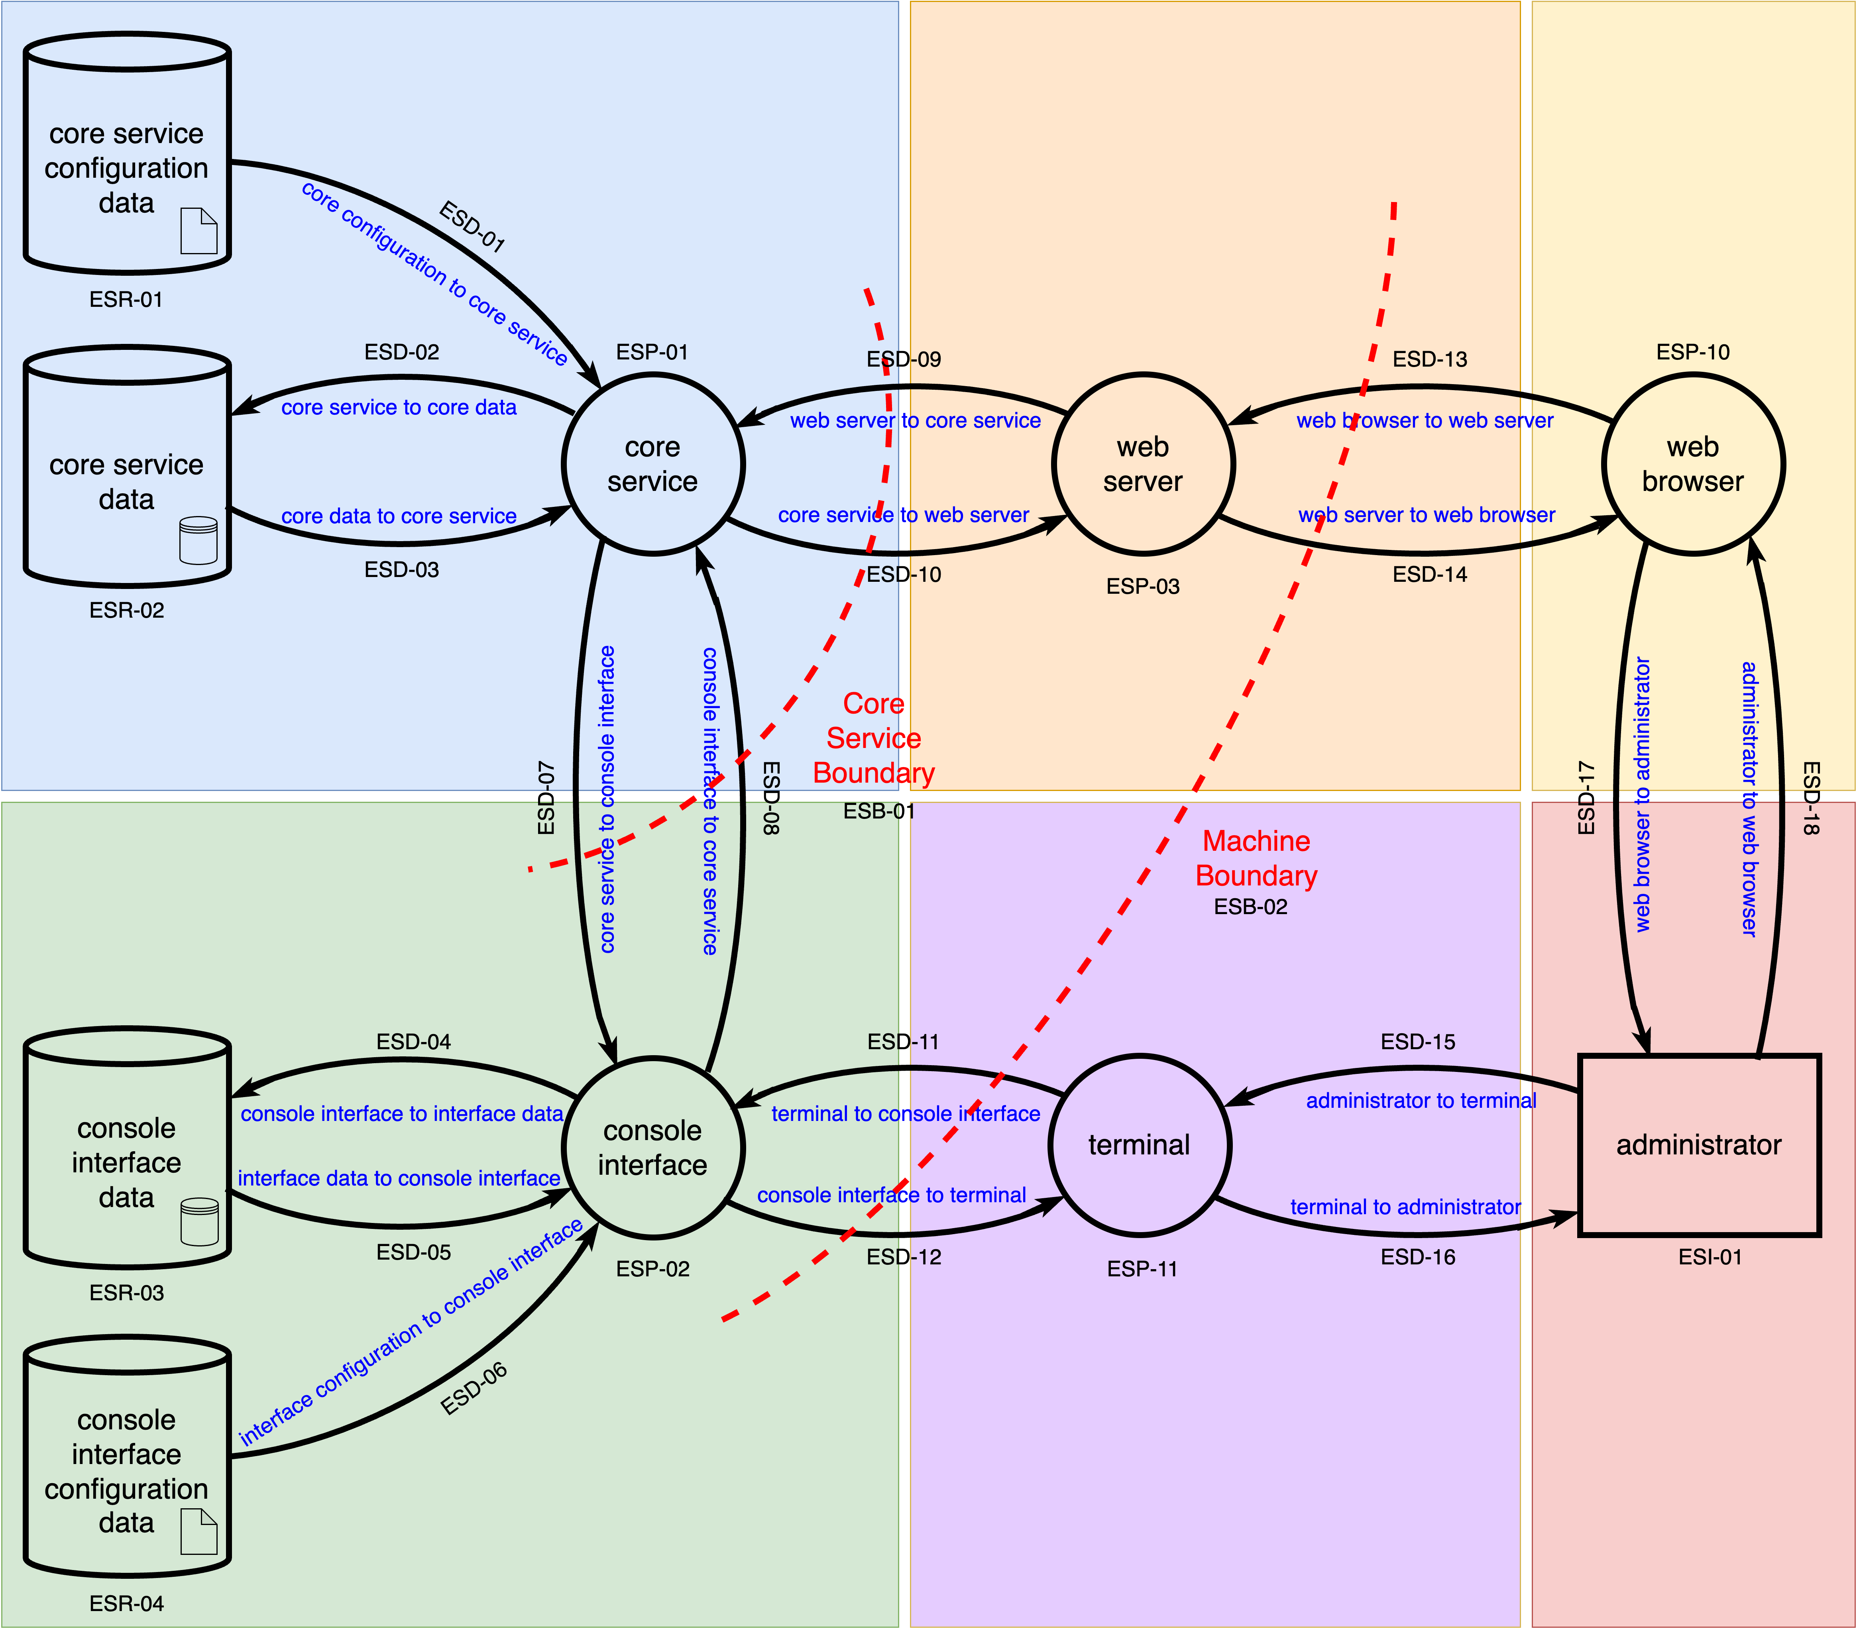
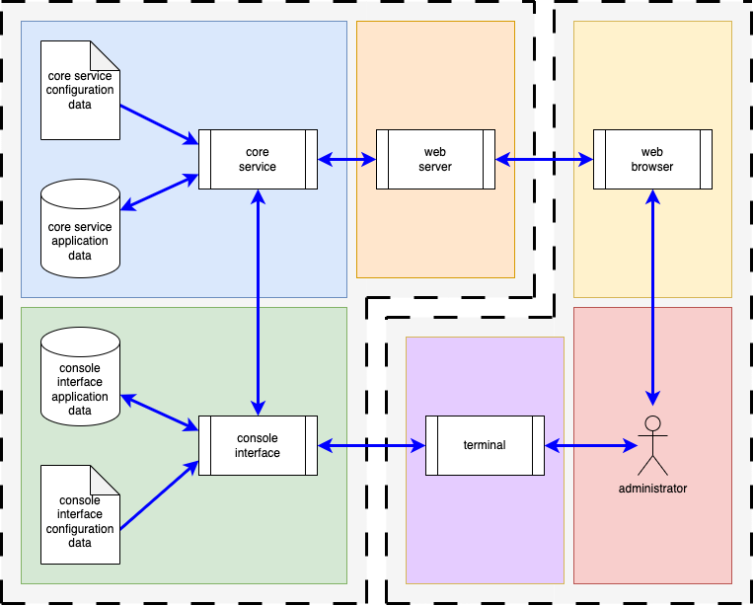
Block Diagram to DFDs
Notes:
Script:
Recall that from the threat modeling model creation video, we took a simple example system,
[pause]
and created
[pause]
Three
[pause]
Increasingly
[pause]
refined DFDs from it.

Slide 9
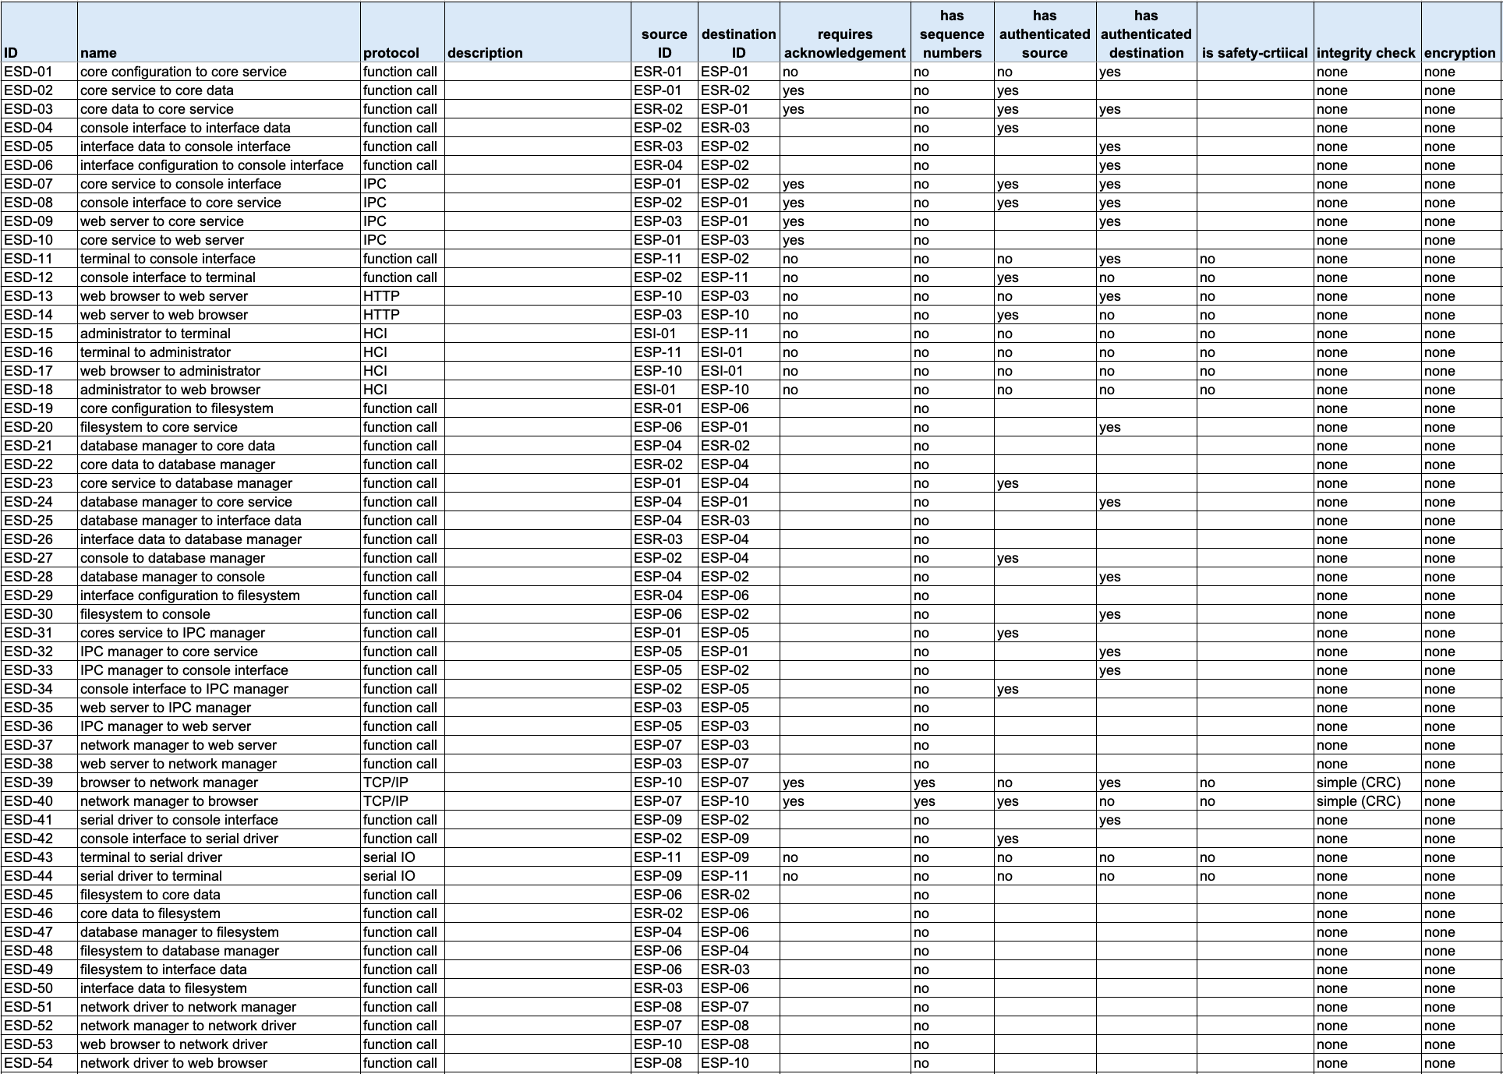
Model Details
data flows
Notes:
Script:
Working with the Development SME, we took those DFDs and extracted features from them.
This was done for the
data flows
resources
interactors
boundaries
and finally, the
processes

Slide 10
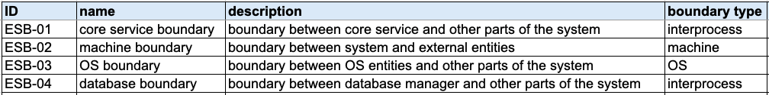
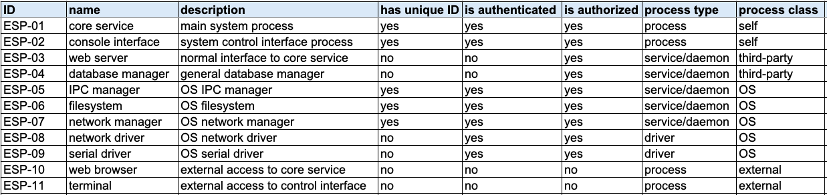
Model Details
resources
interactors
boundaries
processes
Notes:
Script:
Working with the Development SME, we took those DFDs and extracted features from them.
This was done for the
data flows
resources
interactors
boundaries
and finally, the
processes

Slide 11
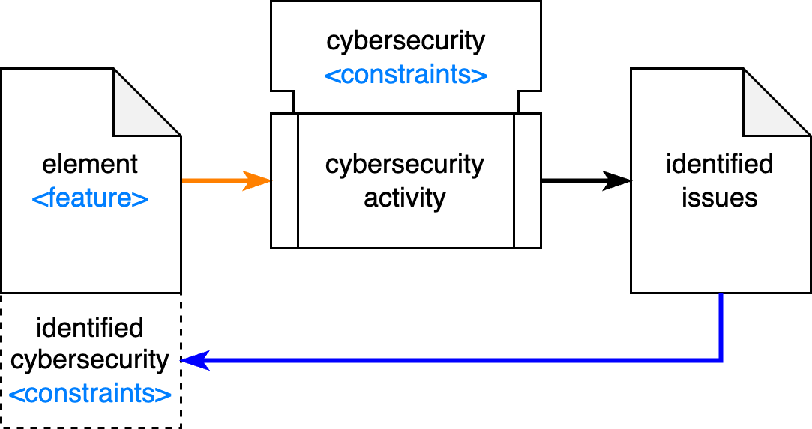
Generalized Cybersecurity Approach
Notes:
Script:
Now let's take a moment to review the generalized cybersecurity approach and how we’ll apply it.
[pause]
Here’s the general cybersecurity activity workflow.
We start with an element feature which in the case of threat modeling is the embodied by the element’s threat model.
[pause]
Both the element and activity are constrained by cybersecurity requirements.
[pause]
The activity produces a set of issues where cybersecurity requirements have been violated.
[pause]
We then either attach these requirements to the element if not already present, or verify they are being applied if they are.
Keep in mind that you can have constraints in place that aren’t implemented.

Slide 12
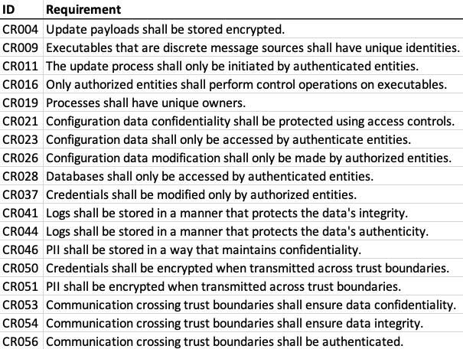
Applicable Cybersecurity Requirements
Notes:
Script:
We use cybersecurity requirements as constraints in threat modeling analysis because the AVCDL's threat modeling approach is based on its cybersecurity requirements taxonomy.
This is not to say that other bases of threat modeling analysis are not possible, merely that this is the one that's supplied with the AVCDL.
For a given organization’s threat modeling basis, there will be a set of constraints.
Those constraints should have a mapping into the cybersecurity requirements, because the cybersecurity requirements are attached to the functional requirements, and that’s what the developers will have to implement.
A threat modeling methodology which does not point back to a set of cybersecurity requirements would be neither useful nor implementable by development.
[pause]
So, here we are with our cybersecurity requirements.
This is not the full set of AVCDL cybersecurity requirements, because not all cybersecurity requirements lend themselves to a treatment within the context of threat modeling, specifically threat modeling where we're using a data flow diagram in order to represent the system.
This is a subset of the global cybersecurity requirements catalog provided with the AVCDL which can be reasoned on within the context of the information contained in a DFD.
It's only about a third of the total number of those global cybersecurity requirements.
As we'll see, we're not going to even use all of these, because not all of them are going to be applicable to our example.
[pause]
One thing that stands out when looking at this set of requirements in the context of the example, is that when the model was created, logging was not included.
In going back and checking with the Development SME, yes, this system does implement logging.
Because of that, before we actually do our analysis, we need to step back and revise the threat model to include this information.

Slide 13
Updating DFDs
Notes:
Script:
Now let's look at each of the DFDs that were created and see where logging needs to be added.

Slide 14
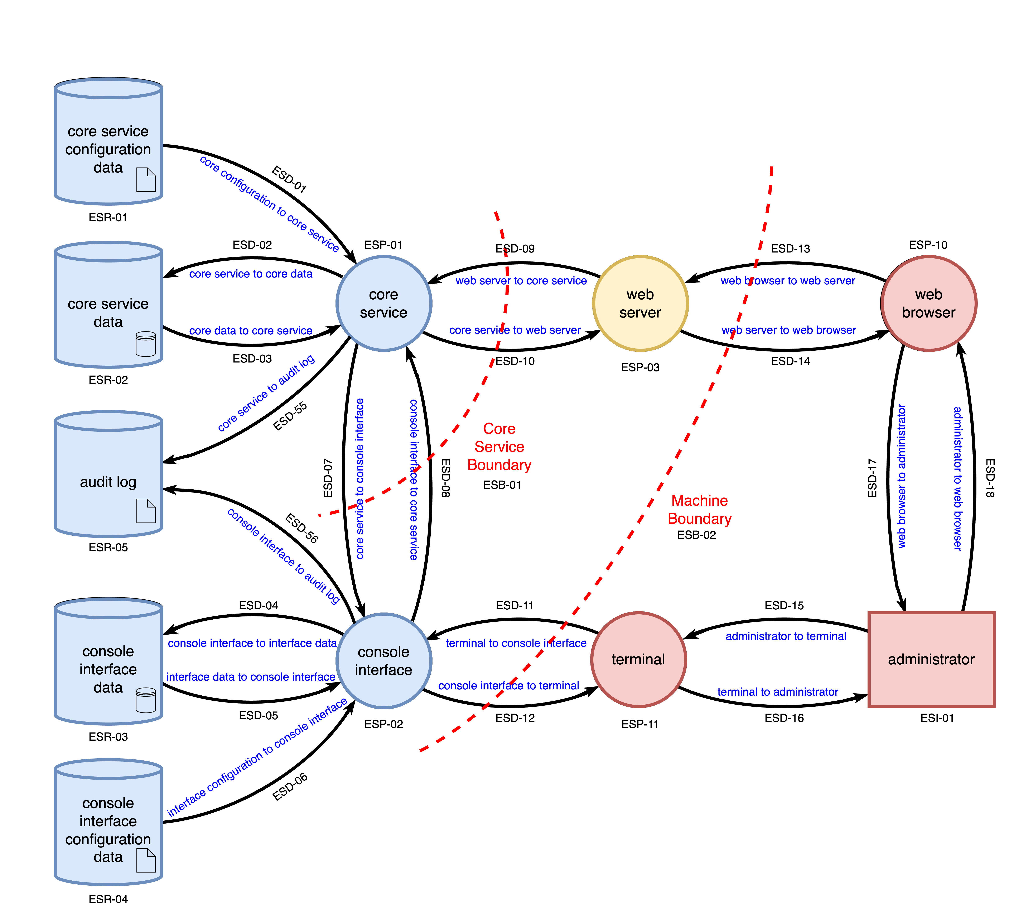
Level 1 DFD
Notes:
Script:
At the highest level, we've established in consultation with the development team that yes, there is an audit log, and it's being used for both the core service and the console interface and here we see it in place.
[pause]
We have a new resource, ESR 5.
[pause]
We have one way data flows from both the core service and the console interface.
[pause]
There's no additional boundary here because, as you can see, the audit log is a trusted resource that technically we own within this context.

Slide 15
Level 2 DFD
Notes:
Script:
As is to be expected at level 2, the audit log is actually being managed by
[pause]
a log manager, and this log manager is a third party piece of software.
It's not part of the operating system.
Because of that, we have not only the log manager, which is now mediating the audit log, but we have
[pause]
a new boundary layer between
[pause]
the core service,
[pause]
log manager, and
[pause]
console interface.

Slide 16
Level 3 DFD
Notes:
Script:
And the last of our big picture DFDs, the level 3 DFD, shows that the log manager is actually using
[pause]
the file system to manage the audit log.
We also have an extension of
[pause]
our OS boundary to include not only
[pause]
the database manager, but also
[pause]
the log manager.

Slide 17
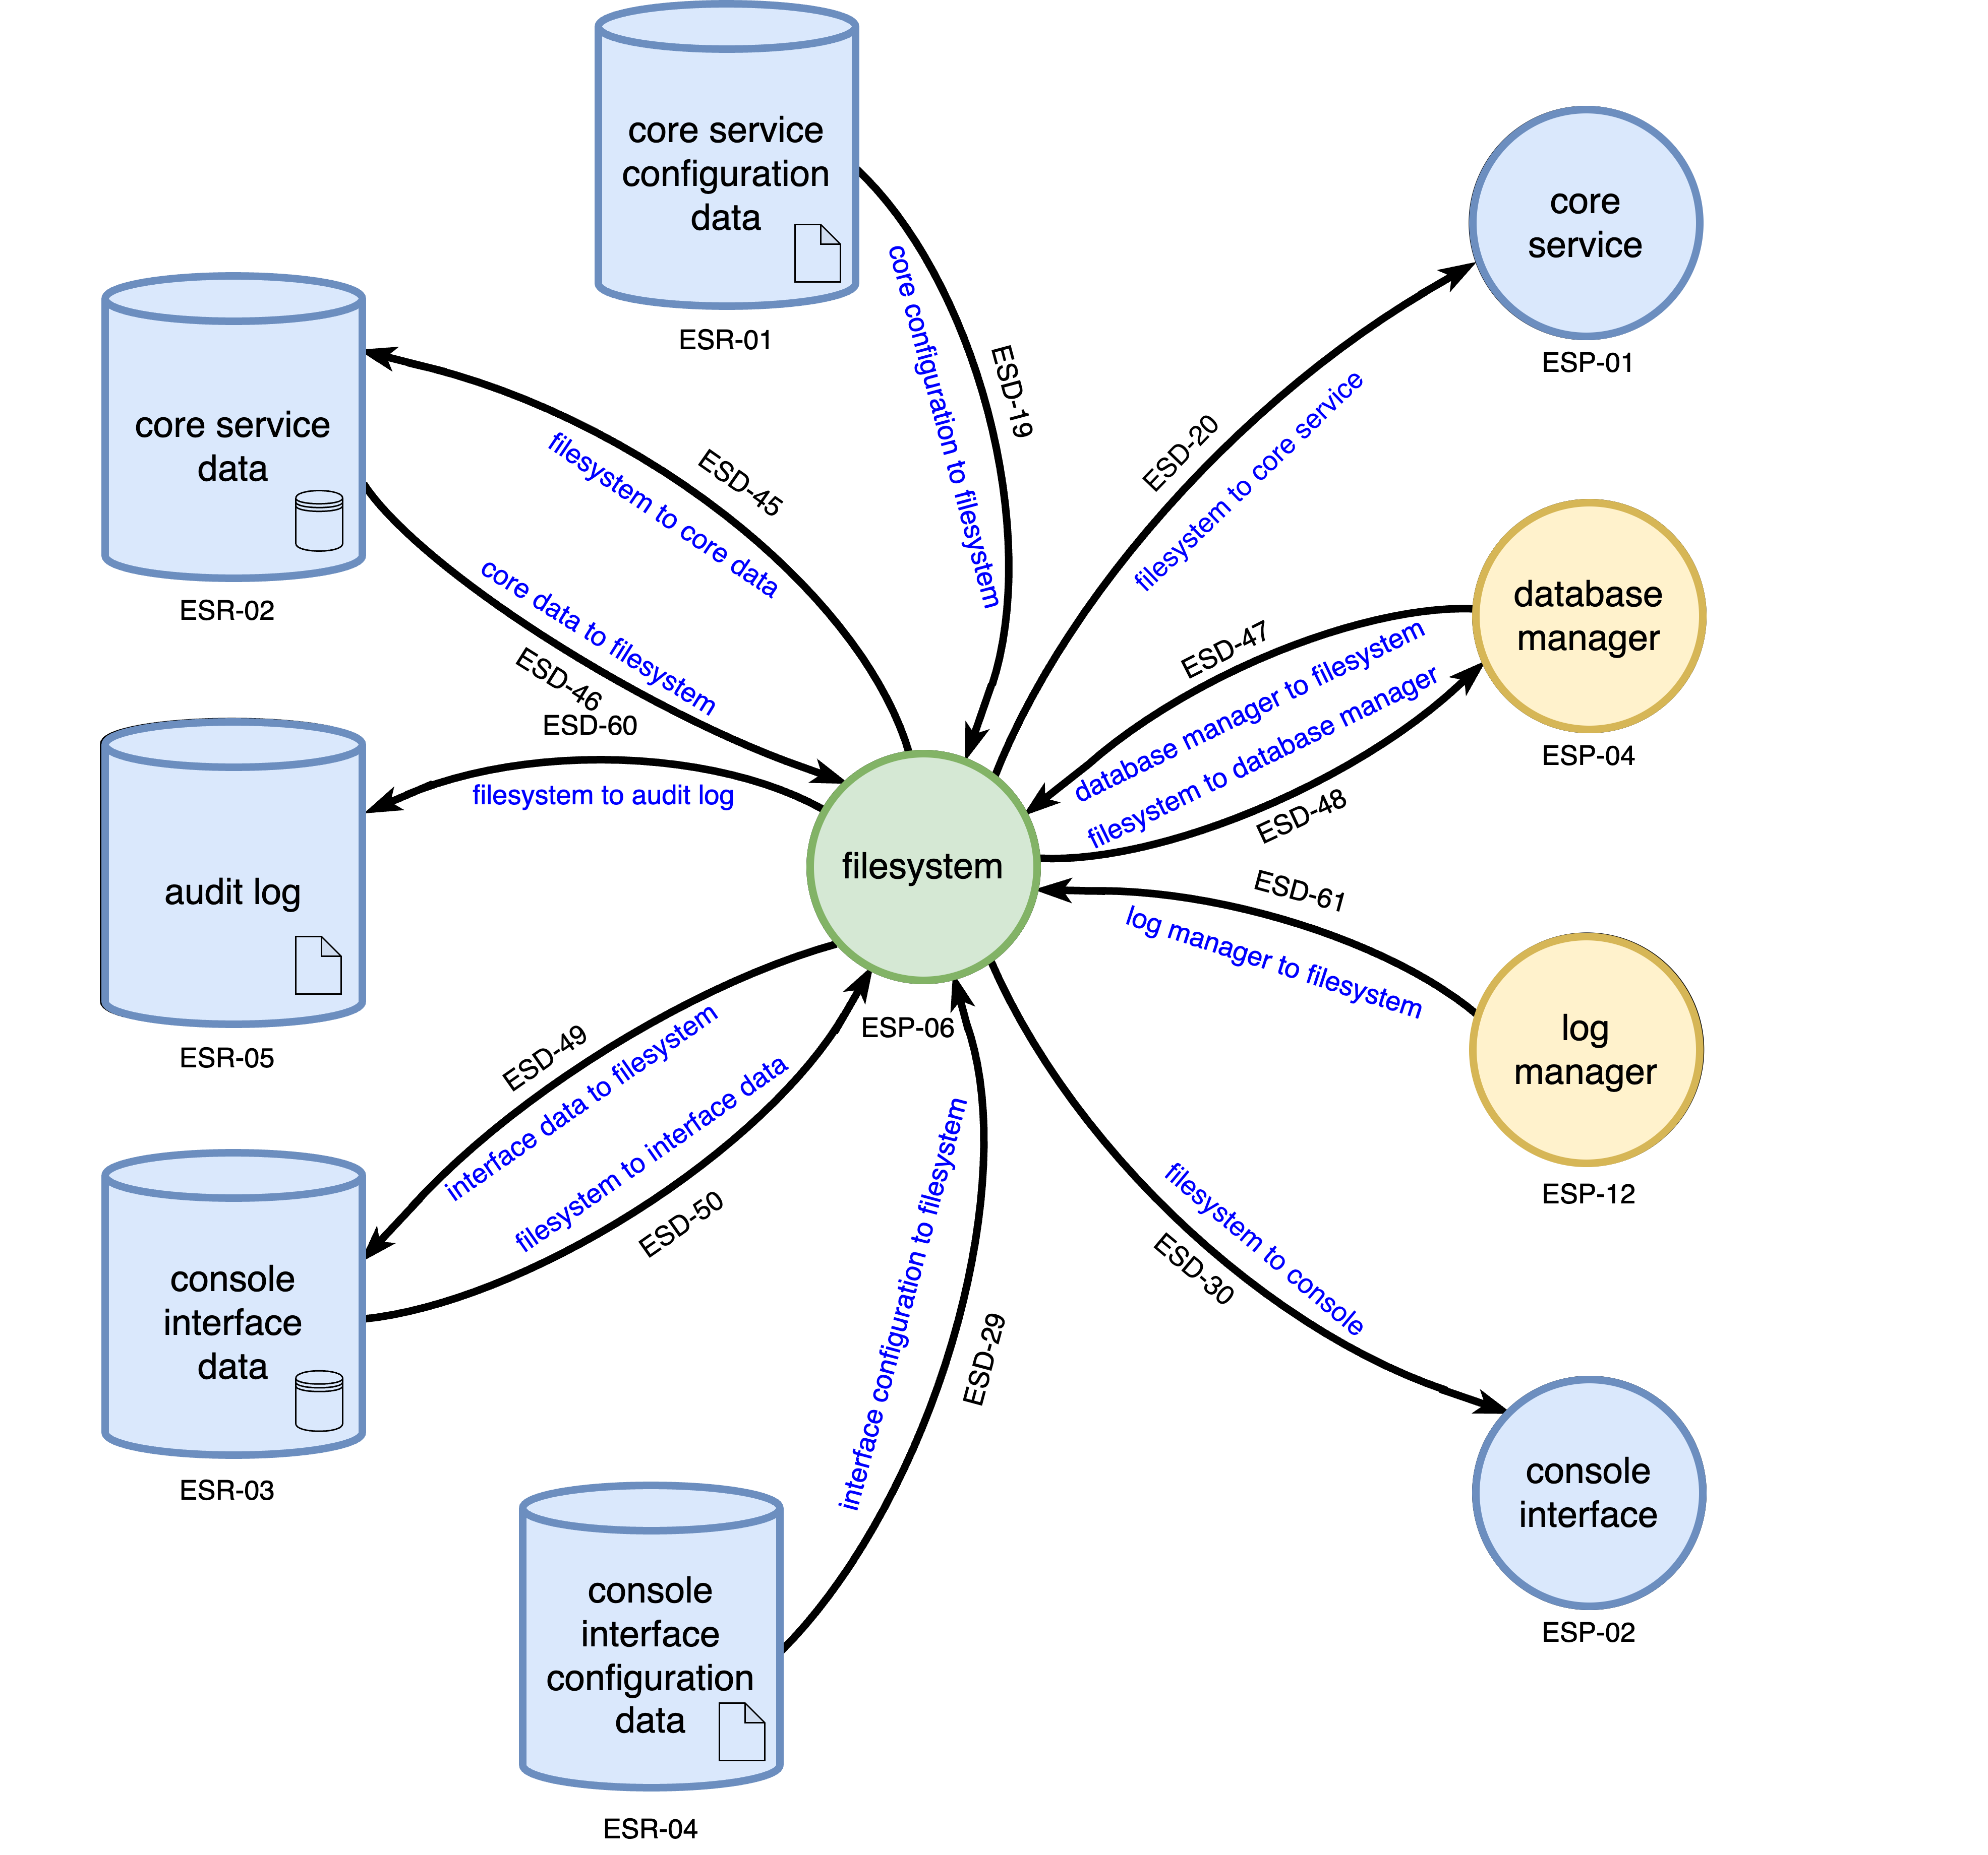
Filesystem
Notes:
Script:
The only operating system-related DFD we need to update is that of the filesystem, because, as mentioned for the Level 3 DFD it’s managing the access to the audit log itself.

Slide 18
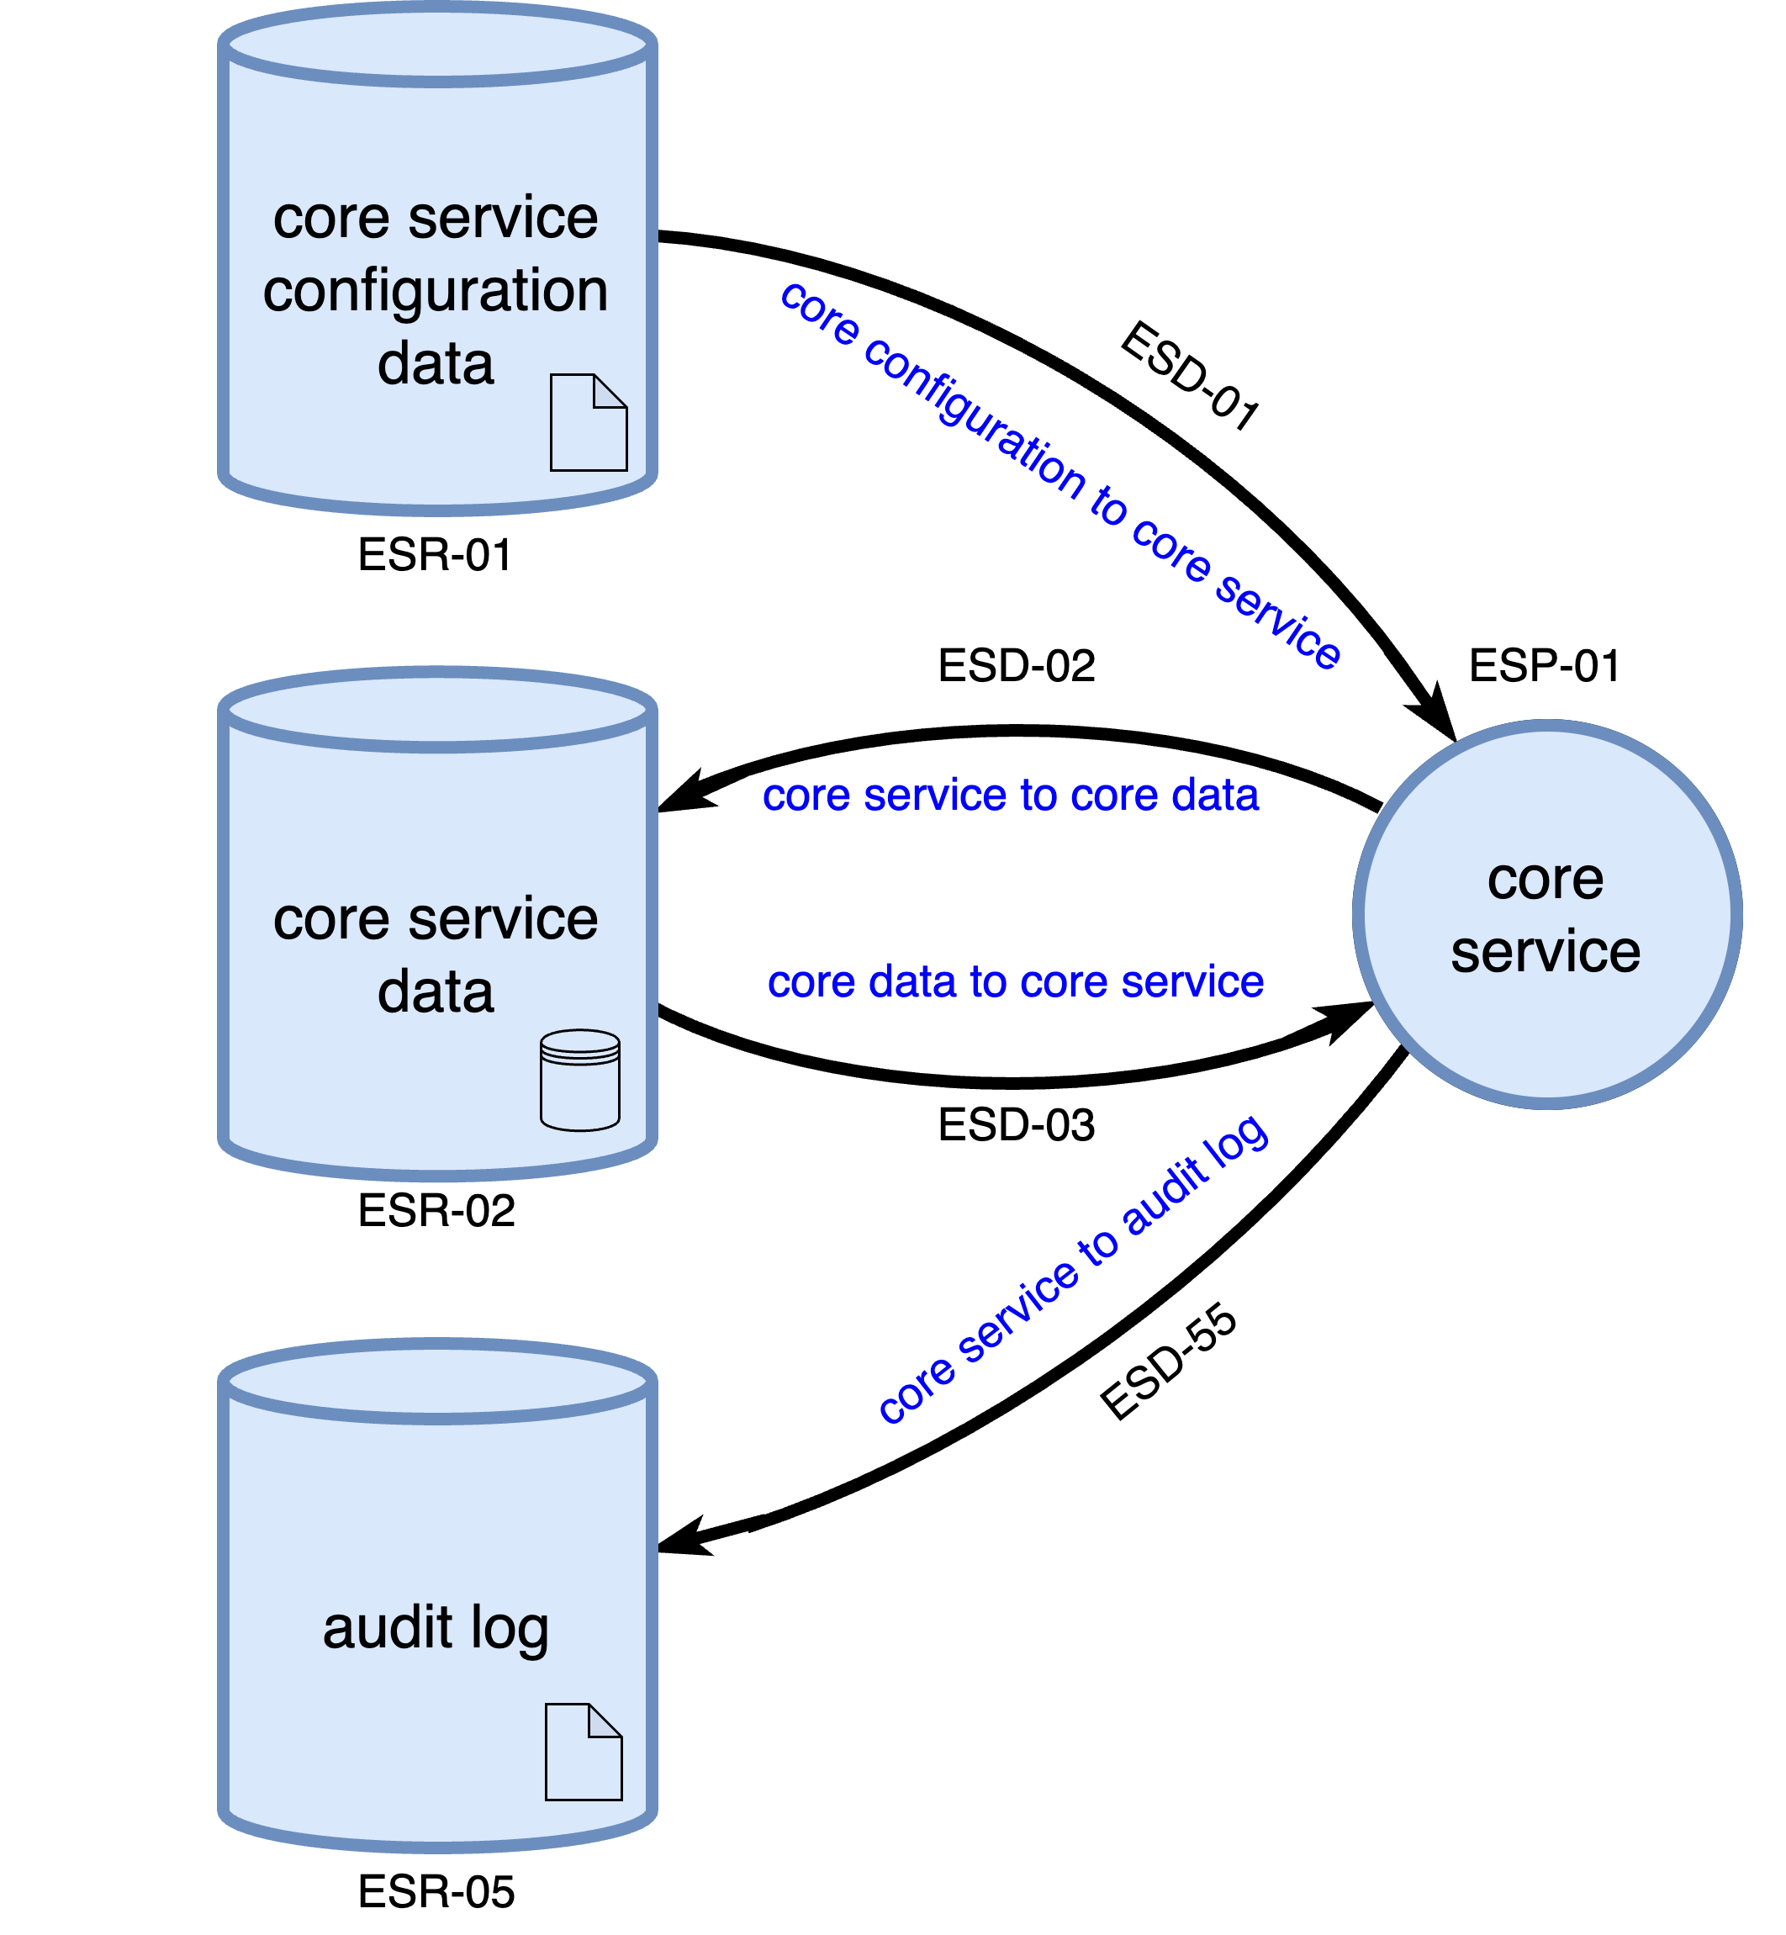
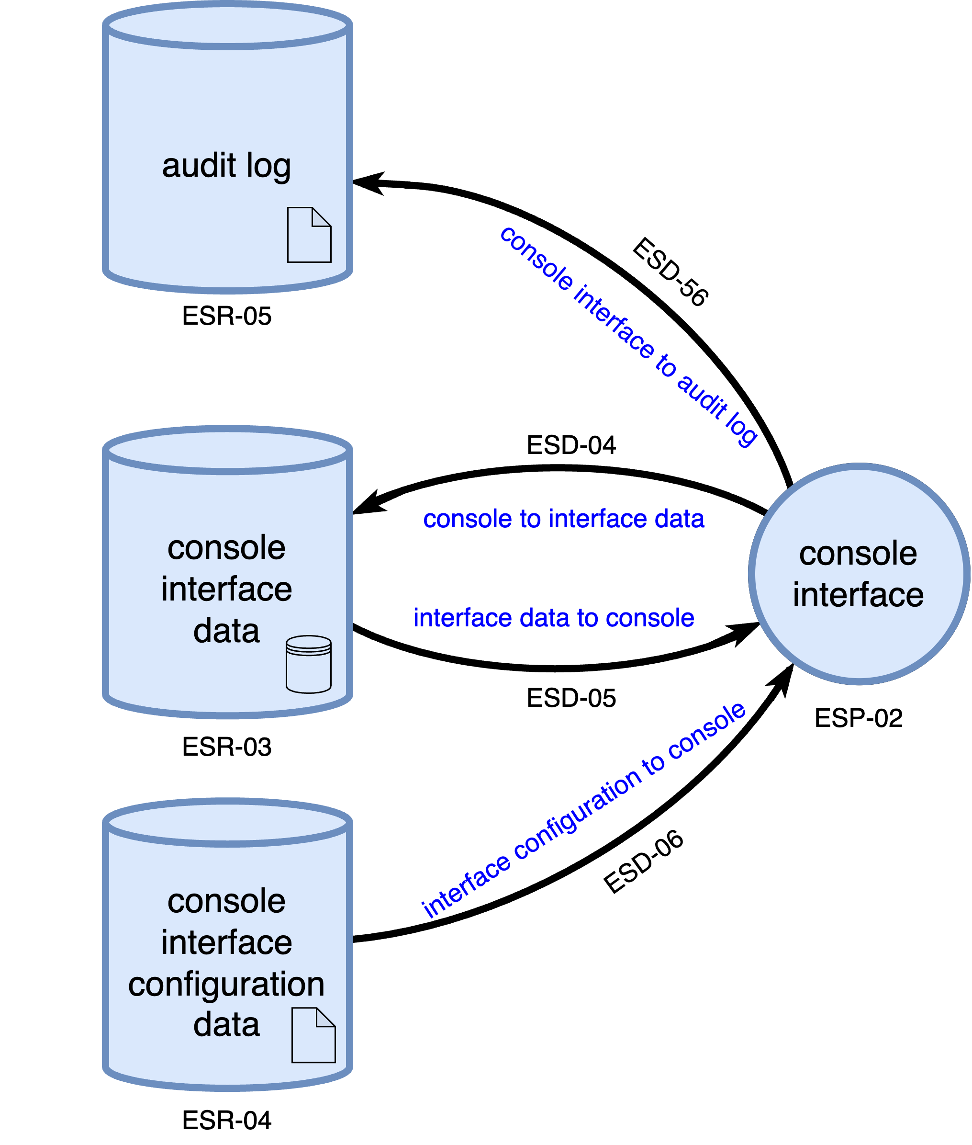
Core Service / Console Interface Initialization
Notes:
Script:
Here's the update for both the core service and console interface initialization processes.
We see the audit log off of both
[pause]
the core service and
[pause]
console interface.
These are specialized versions from the level 1 DFD.

Slide 19
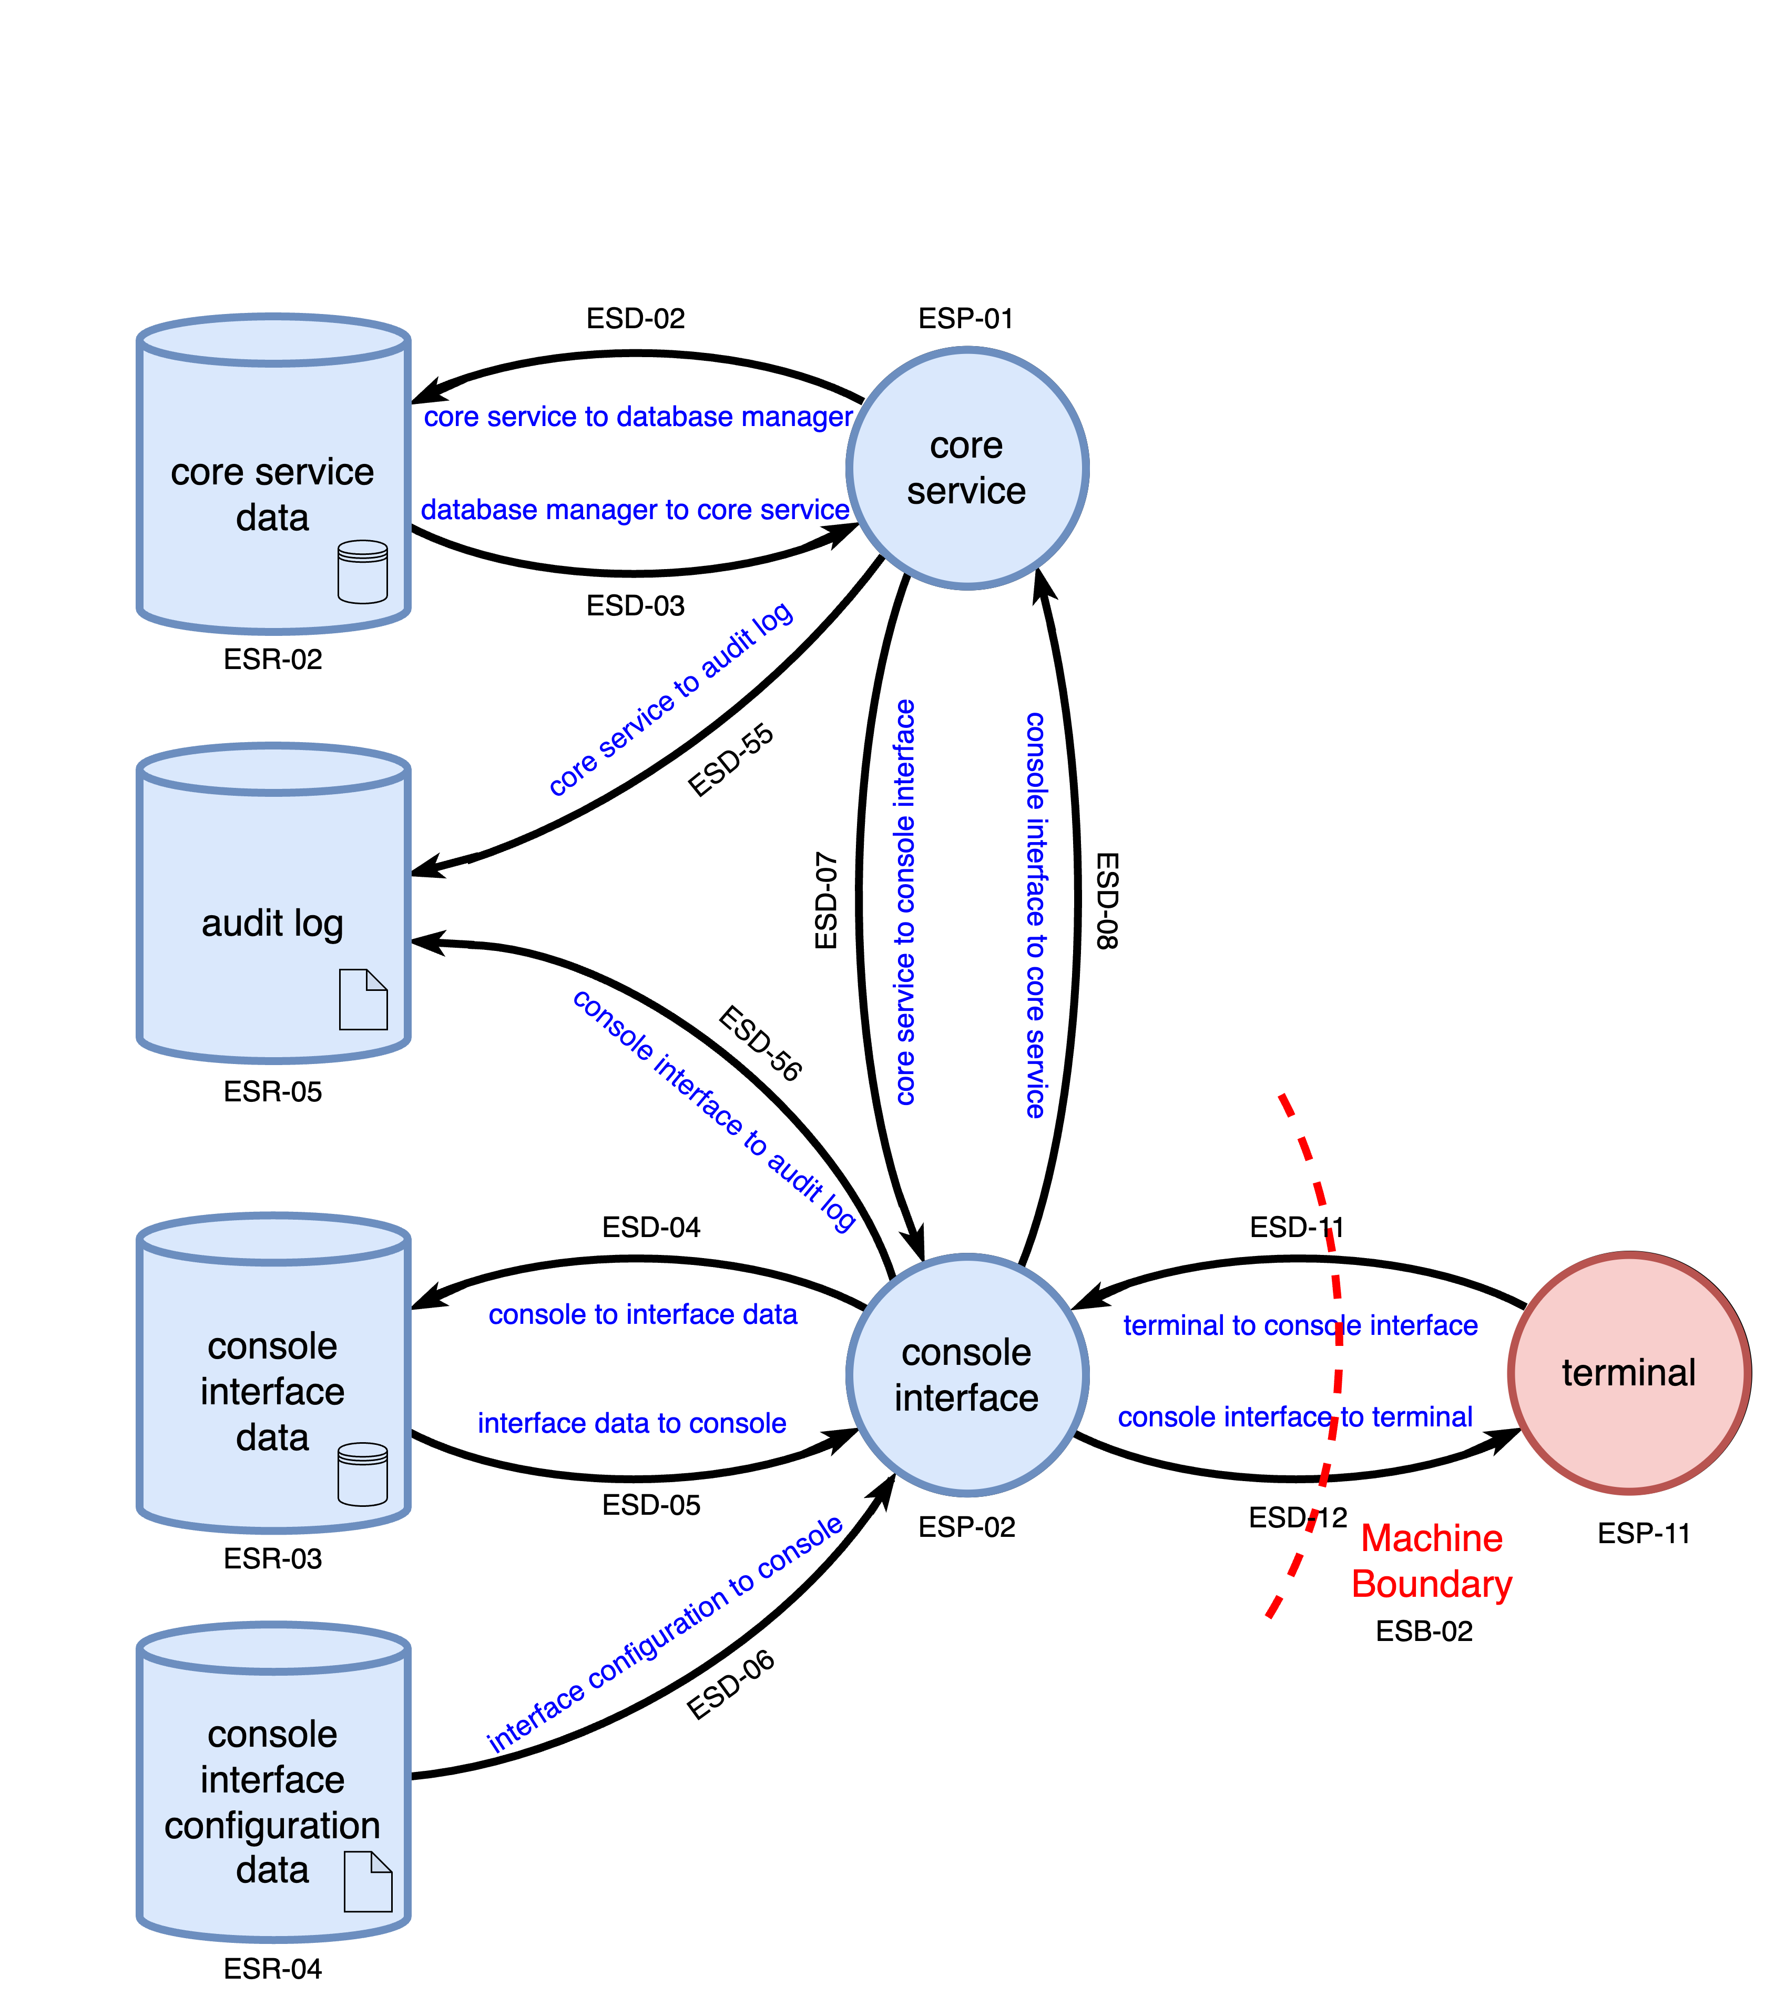
Core Service Configuration
Notes:
Script:
Here's the core service configuration workflow.
Both the core service and console interface
[pause]
write to the audit log.

Slide 20
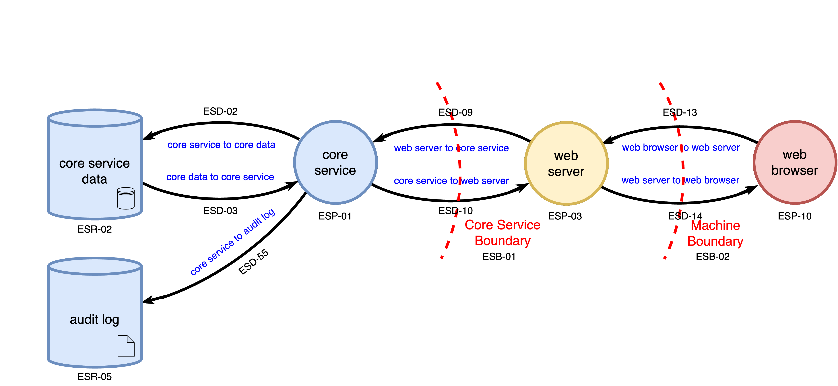
Normal Operation
Notes:
Script:
And here is the final update for our logs, it’s for the normal operation workflow, where the core service
[pause]
logs what it's doing.
A note here, the web server has been noted previously as a third party component, and as we can see, it is not using this audit log.
Now, that might be an issue for design, but from the standpoint of what we're considering here, it doesn't write to the audit log.
There is another problem here though, and that is one that's been described before to motivate the increased resolution of the levels 2 and 3 DFDs.
And that was to add the bits and pieces that were missing so that we could see data flows that weren't exposed previously.
A different approach not taken when the model was created was that of greater abstraction.
We have here a flow, or communication sequence that goes from the core service to the web server to the web browser, and vice versa.
What we don't have is a way to talk about the web browser communicating directly with the core service.
We've got HTTP communication between the web server and browser and IPC communication between the server and the core service, but nothing between showing the application level messaging and data that's being passed.
So, let's look at what that additional workflow looks like.

Slide 21
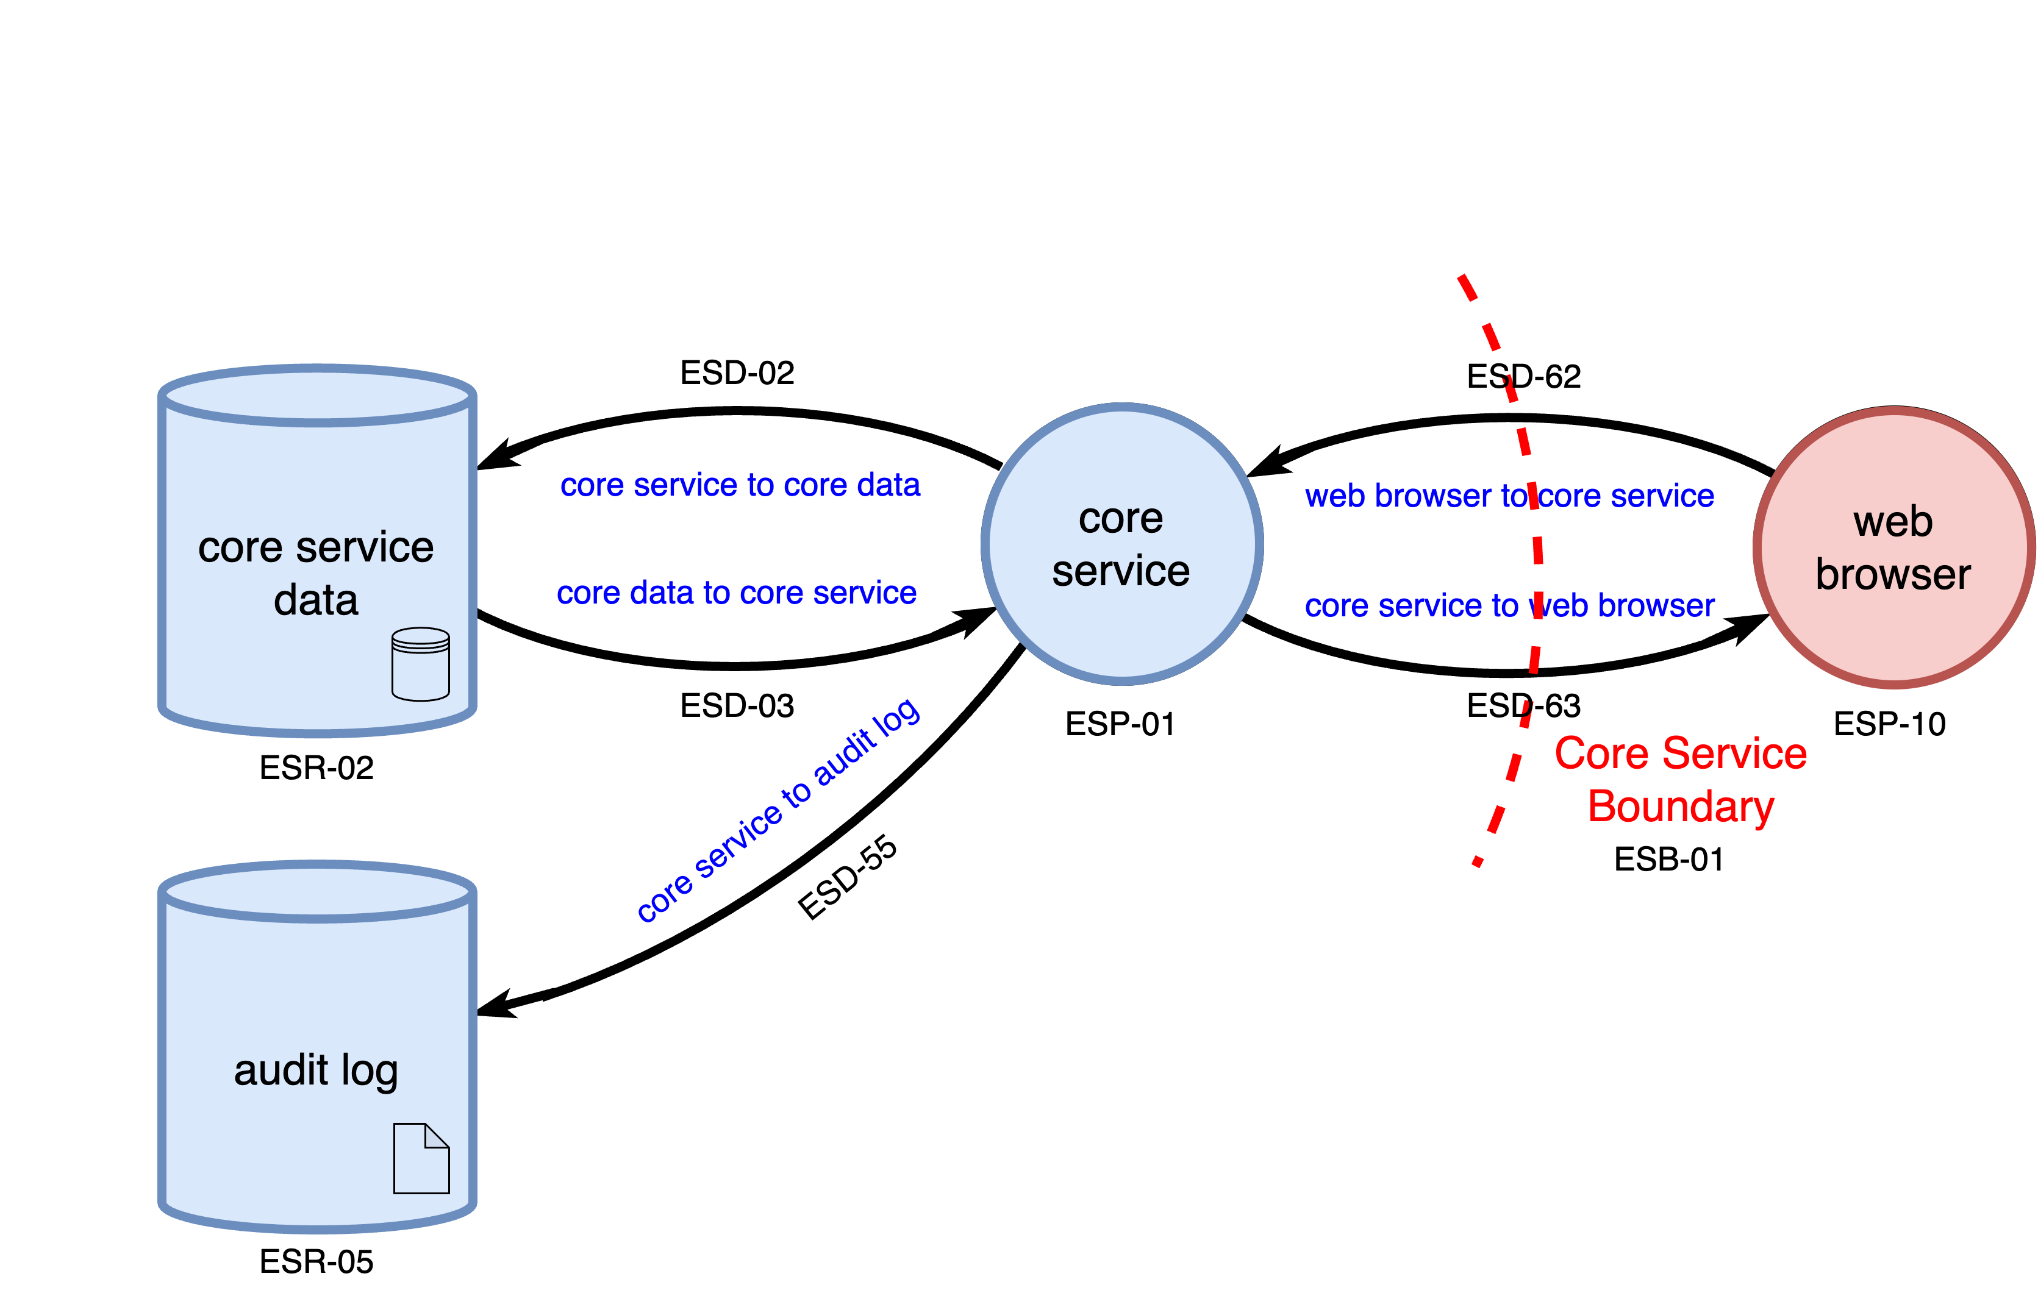
Normal Operation – End-to-End
Notes:
Script:
Here is the normal operation at its most abstract level.
This is where we can reason about the type of communication that's going on between the core service and the web browser itself.
Note that the core service boundary shown here could have been the machine boundary.
It's arbitrary which we use.
Now that we've gotten the diagramming covered, let's look at what the implications are for the DFD entity lists.

Slide 22
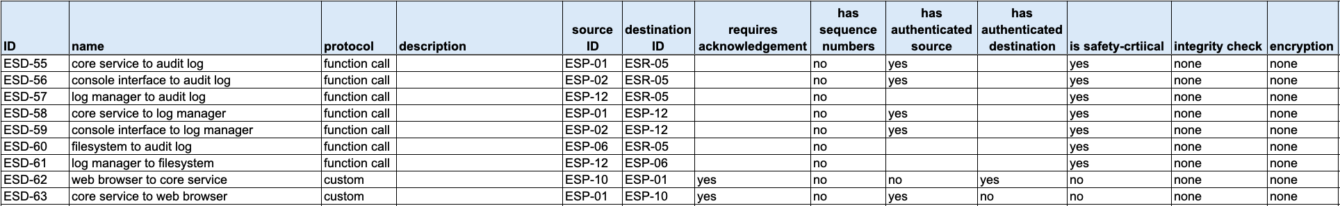
Entity Updates
resources
processes
boundaries
data flows
Notes:
Script:
Here are entity updates.
As you can see, we've got our resource, the audit log.
[pause]
our process, the log manager.
[pause]
our boundary, the log boundary.
[pause]
There are seven new data flows dealing specifically with the audit log,
[pause]
and two for the end-to-end communication between the web browser and core service.
All this information gets put into an updated revision of the threat model.
You might be wondering why this diversion in order to update the threat model when this is a video about threat model analysis.
Well, making sure that you're working with the right information is a normal part of the analysis activity.
And updating the model, if it needs to be updated, is critical to performing a proper analysis.
You don't just take what's there and blindly do the analysis activity thinking, well, they gave me this, I'm just going to do it.
That's not a responsible approach.

Slide 23
Analysis
Notes:
Script:
Now with all the material up-to-date, let's proceed with the analysis.

Slide 24
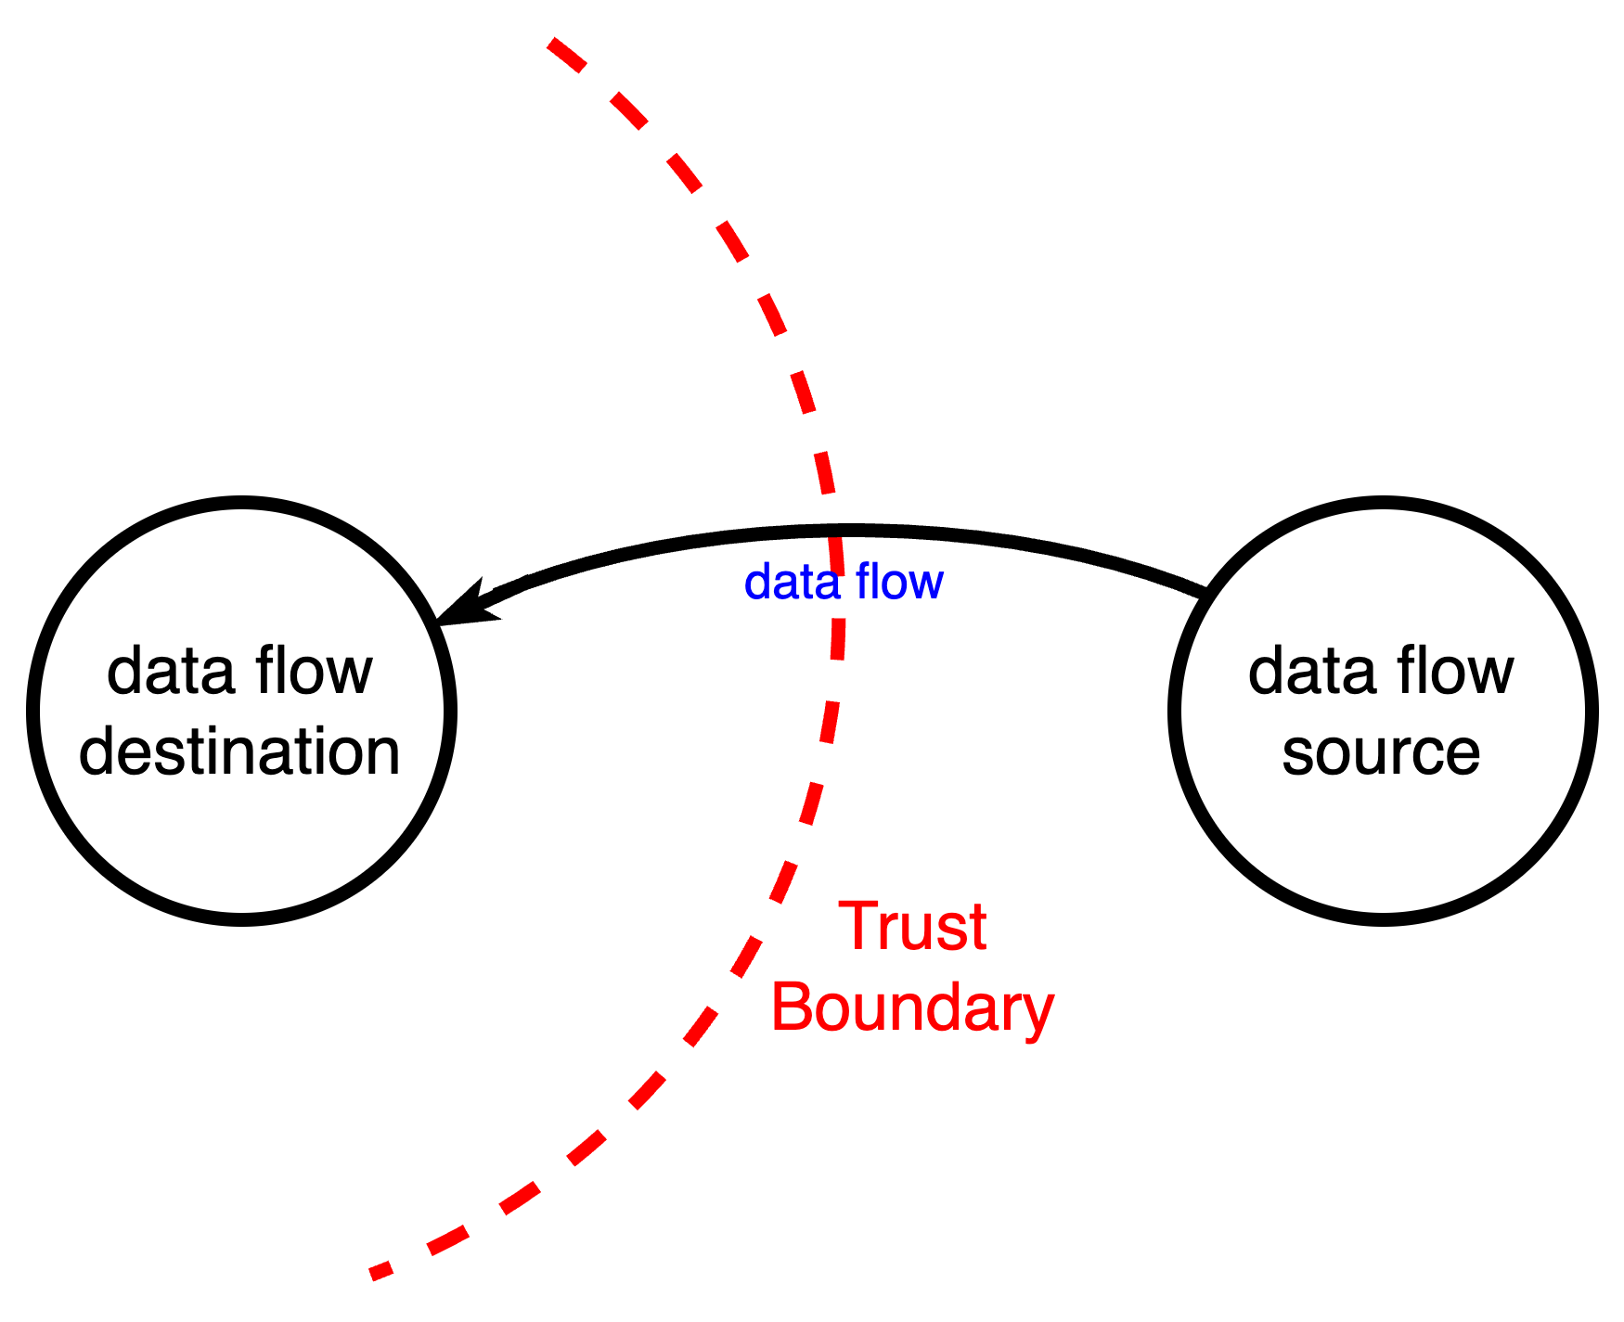
Methodology
Notes:
Script:
The methodology we'll use to do the threat modeling analysis is to take the element features which is the DFD,
[pause]
the cybersecurity constraint information embodied in the attributes that we've collected for each of the entities in that DFD,
[pause]
our cybersecurity constraints represented by the subset of the cybersecurity requirements.
[pause]
And we're going to individually apply the requirements to each of the data flows and reason on them based on the information that we have regarding the data flow, the source and destination and the trust boundary crossed.

Slide 25
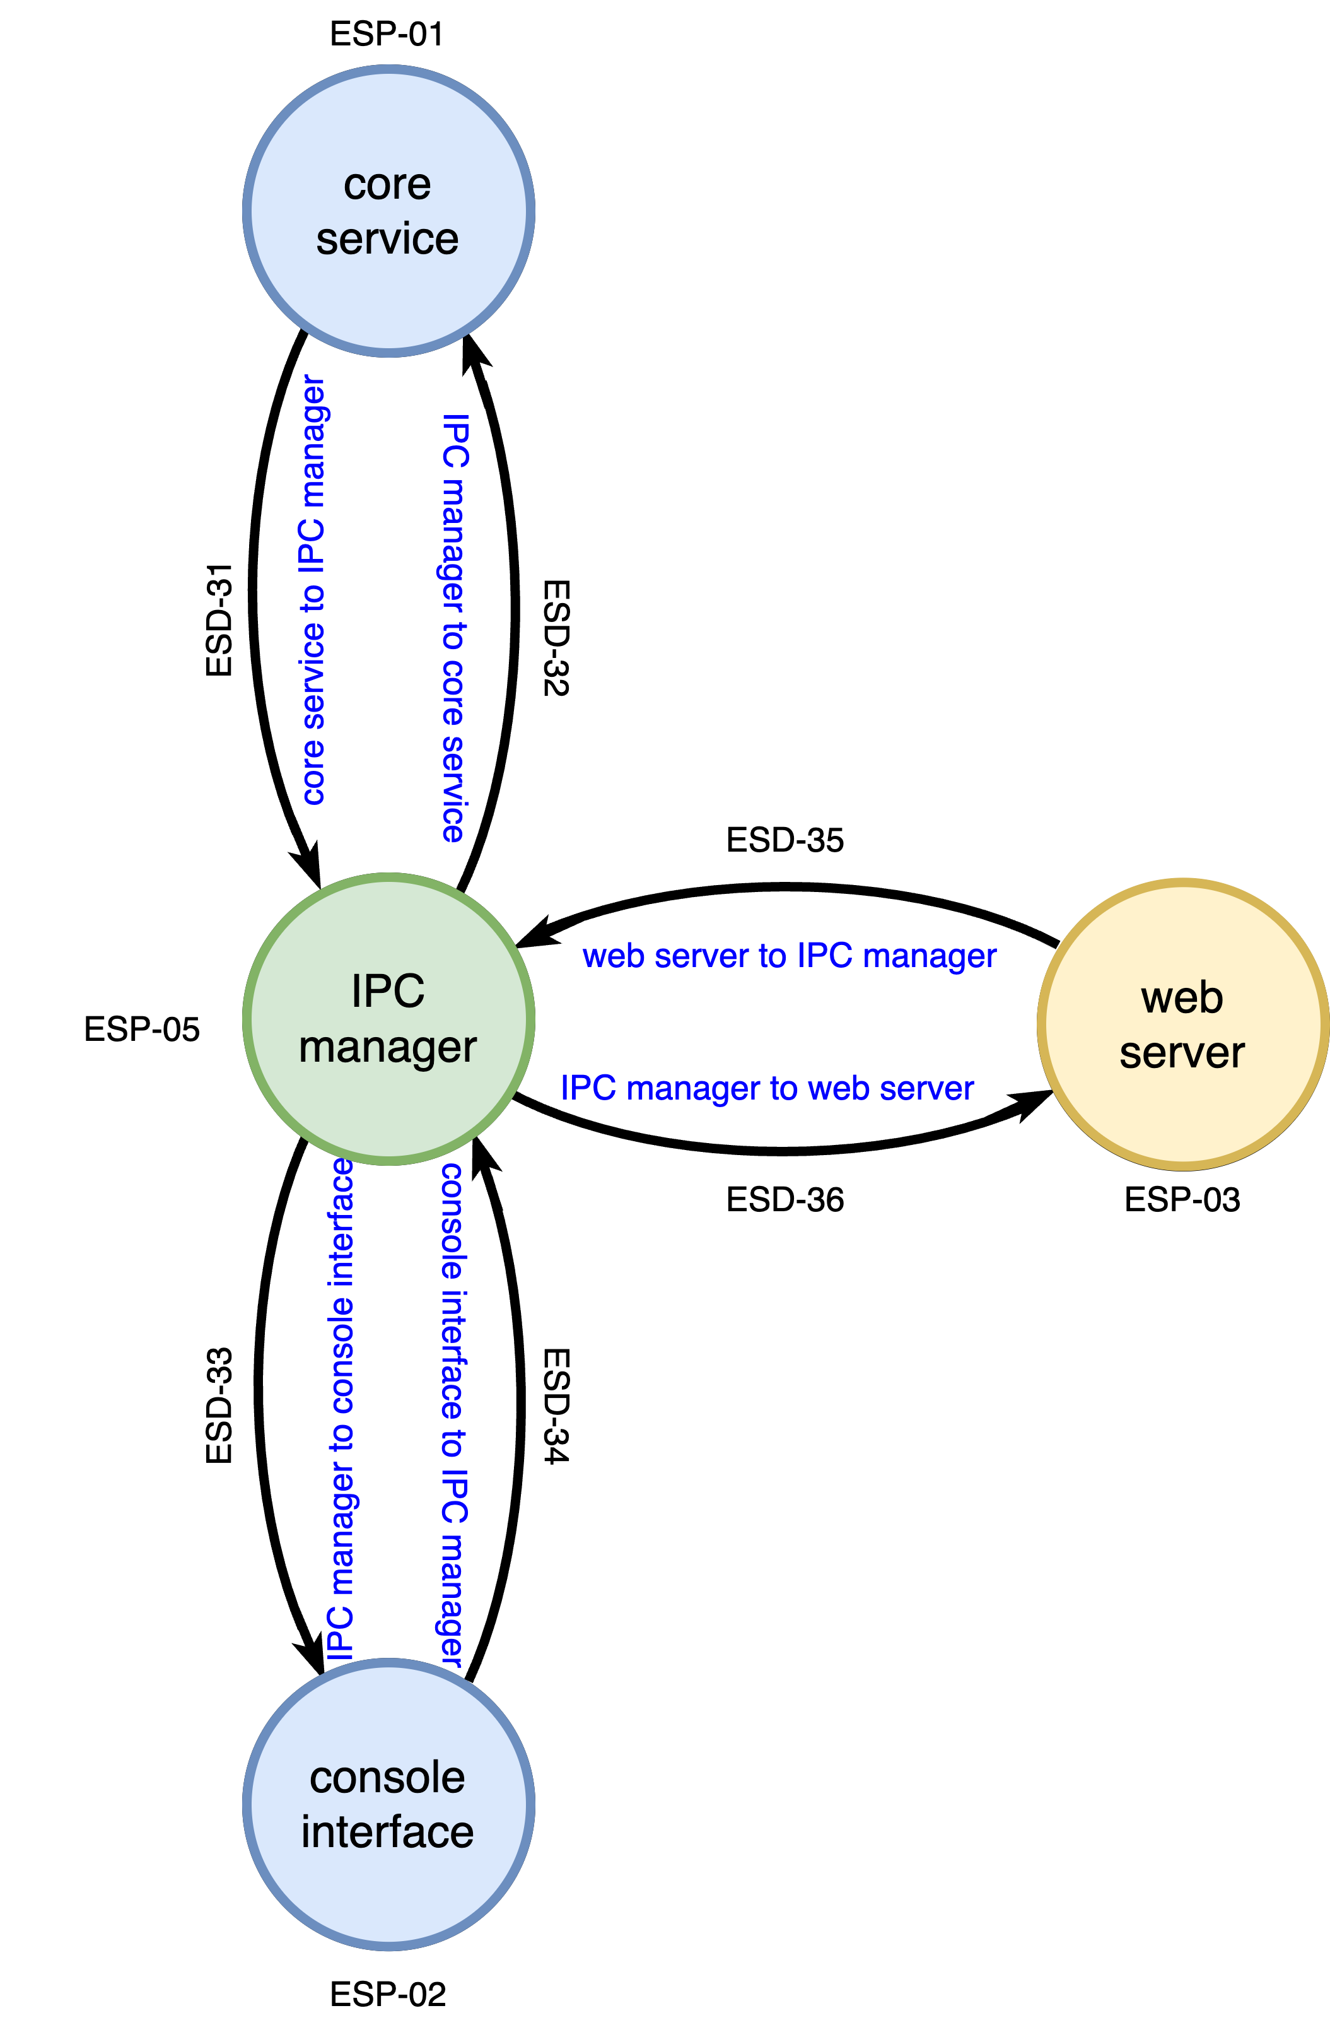
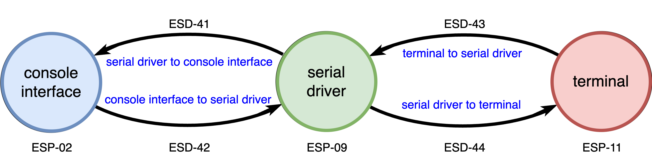
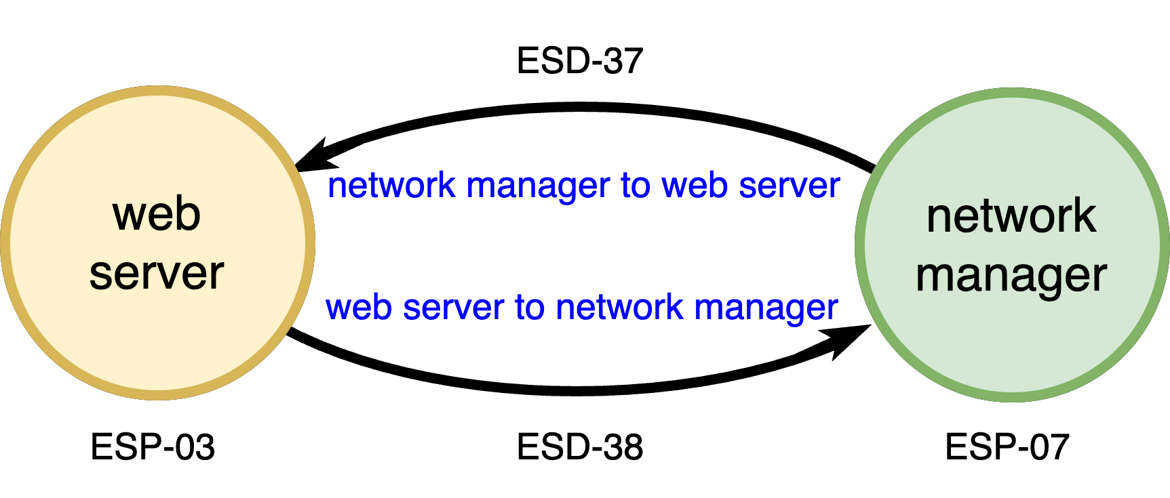
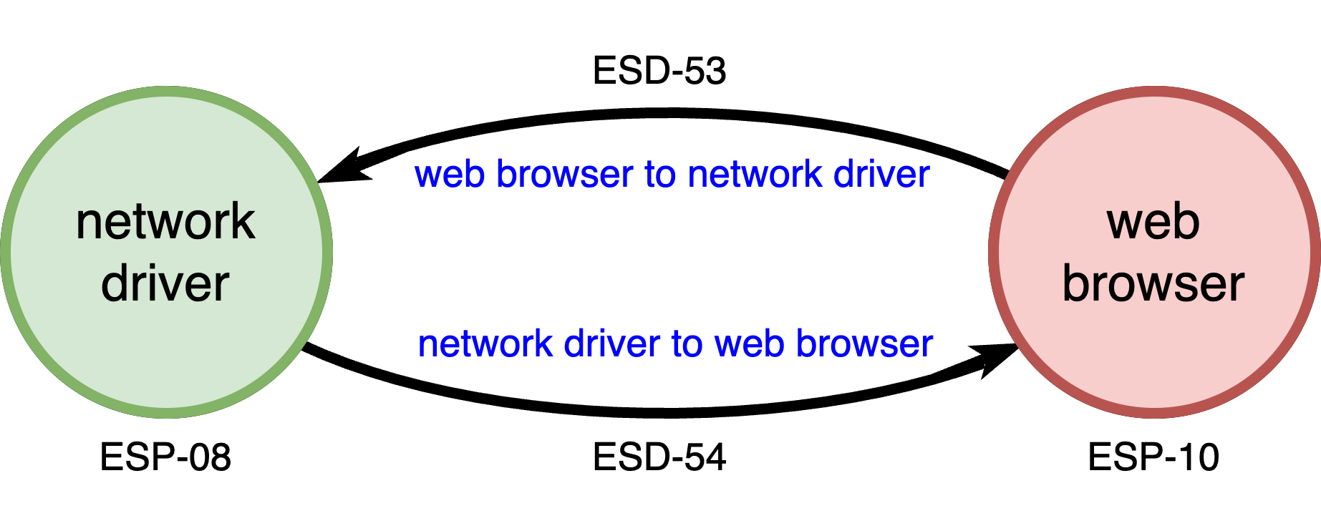
OS DFDs
Notes:
Script:
Here are all of our operating system DFDs.
As mentioned in the model creation video, these are not going to be considered in our analysis, since the focus of our analysis is the element.
Be aware that it's important to document these DFDs because we do need to do a separate analysis of the operating system, and these DFDs inform that analysis.

Slide 26
Workflow DFDs
Notes:
Script:
Here are all of our operating system DFDs.
As mentioned in the model creation video, these are not going to be considered in our analysis, since our analysis focus is on the element.
Be aware that it's important to document these DFDs because we do need to do a separate analysis of the operating system, and these DFDs inform that analysis.
Workflow DFDs
That leaves us with the element’s workflow DFDs.
We could do a complete analysis on each and every one of these data flows, but let's assume that your organization doesn't have infinite time or infinite resources to explore this.
The way to get the most impact from your analysis is to look at those things that are at the trust boundaries.
As you can see here, the vast number of entities within these workflows are trusted.
So, what we’ll do is focus on those workflows where we have untrusted entities.
The one we're going to be looking at from this example are in the normal operation workflow.

Slide 27
Normal Operation Analysis
Notes:
Script:
As mentioned earlier, we're going to take our DFD, just our data flows in this case.
And our requirements and perform the analysis by looking at each data flow in turn considering what the applicable requirements are, then determine whether those requirements are met.
We'll make that determination by looking at the various attributes of each of the data flows and possibly the attributes of the source and destination entities.
Where there is either a lack of information, or a violation of the requirement, we'll generate an issue.
Our focus is on the core service, web server, and web browser data flows, which are crossing either the core service or machine boundary.
The core service is, of course, the trusted portion of the element.
It interacts with a third-party web server, which has a lower trust level, and finally communicates to the outside world, that is to the web browser.
There are four data flows, the ones between the core service and web server are using the systems IPC protocol.
And those between the web server and web browser are using the HTTP protocol.
These protocols have distinct behavioral characteristics.
We can't simply say, we've got a data flow, and things are happening.
The protocol is important because it speaks to how we're going to be reasoning on the applicability of the requirements.
Now in reviewing our applicable cybersecurity requirements, we can quickly eliminate all of them until we get to the last three.
These are
• communication crossing a trust boundary shall ensure data confidentiality
• communication crossing a trust boundary shall ensure data integrity
and
• communication crossing a trust boundary shall be authenticated
These are the three requirements we'll apply to our selected data flows.
There’s an interesting thing to note here.
As we look at the attributes provided in threat model creation we have gaps.
But, as noted, gaps should not be unexpected.
One gap that is unexpected is in ESD 10, the core service to web server data flow.
We can see that it doesn't show that we have an authenticated source.
This is a trusted entity, so it is considered to be authenticated by definition.
So, we're going to have to go back and adjust some attributes.
Since it doesn't impact the rest of our analysis, we don't have to do anything more elaborate in terms of the threat model itself.
Just recognize the fact that there are certain things that may have been left out, which are simply clerical errors, if you will.
For the other attributes however, if something isn't provided, then assume that that it's a no.
Another thing to note is that the safety criticality attribute informs us as to what we prioritize, rather than something that we actually reason on.
In the same way that we deprioritize the operating system workflows because all of those flows are handled separately, and that we aren't looking immediately at the workflows which are in our trust zone, we look at safety criticality and ask, we've got all of these things, which ones are safety critical?
We make sure to address those first, because you have to prioritize the issues to be mitigated.
The best way to do so is to take the safety critical ones first, then address the remainder.

Slide 28
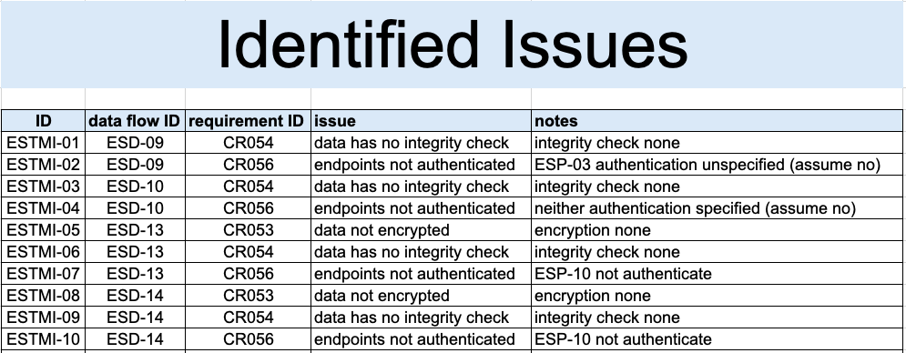
Issues
Notes:
Script:
Having done the analysis, we found ten issues.
Because of the nature of the issues, they're fairly straightforward to deal with.
For the integrity check, we have an attribute for every one of the entities in question here, and the integrity check is set to none for all of them.
Similarly, encryption is set to none.
So, the concepts of having integrity and confidentiality are basically thrown out the window.
When it comes to authentication, we want to ensure that both ends are authenticated.
And if, as shown here with our data, we don't have an assertion that we have authentication at one end or the other, then that's something that we need to look into.
As you can see here, we have an ID for each of the issues.
We have a data flow ID to tie us back to where we're talking about, and we have the cybersecurity requirement ID.
We have the issue, which is essentially the inverse of the requirement, and we have notes, which tell us what in particular is causing the problem.
Note that the provided issues template doesn't have fields for the original functional requirement or any of that information because that's something we get from the threat model metadata.

Slide 29
Recap
Notes:
Script:
We’ve seen how to translate a block diagram of the element into a series of DFD views.
We’ve covered what the attributes for each DFD entity type are and how they are motivated.
We’ve worked through a realistic example system.
We’ve motivated why having a series of simple targeted views is superior to a single big bang DFD.
[pause]
That covers the basics of how you would create a DFD-based threat model.
This is not to say that all questions could possibly be answered.
However, the materials that have been provided should cover most things.

Slide 30
Practical Approach
Review the DFDs
Focus on element workflows
Perform analysis ordered by trust level and criticality
Keep it up-to-date
No special tooling required
Notes:
Script:
When undertaking threat modeling analysis, it's important to take a practical approach.
Remember to review the DFDs.
People make mistakes, and DFDs are no exception.
If you find issues in the DFDs, correct them right then and there.
[pause]
When you're deciding what to analyze, focus on the element workflows.
Remember that the operating system flows are something that are common to all elements.
They should be analyzed together.
If you add a new entity that's going to be working with the operating system, then that should go into the operating system DFD set and analyzed there, so that you have a coherent analysis for the operating system itself, regardless of what elements you adding to it.
[pause]
Perform the analysis ordered by trust level and criticality.
Don't spend a lot of effort straight away on things where there is no issue of trust.
If an entity is trusted, then its actions cannot be prevented.
Focus on those areas where there is a disparity in trust.
Special attention needs to be given to the most critical items.
[pause]
Remember that this is not a one-shot activity and that you have to keep this up-to-date based on changes to the design.
[pause]
Finally, you don't need special tooling to do threat modeling.
It can be really helpful to have automated tools but trusting automated tools simply because they're automated is not appropriate.
You need to know what's being analyzed.
You need to understand how the analysis is being undertaken
And you need to appreciate the limitations of the tooling.
If you can perform threat modeling, as shown here, in a very manual manner, you can do so in an automated manner.
If all you can do is use the automated tool, and you don't understand what the fundamentals are, then your effectiveness as a cybersecurity threat modeling SME will be greatly hampered.

Slide 31
Example Materials
<AVCDL>/source/reference_documents/working_material/example system/
Notes:
Script:
The materials that were used to cover this example are in this location shown here.
It's important to note that this includes the DFDs, as well as the threat model, model creation, and issue tracking workbooks.

Slide 32
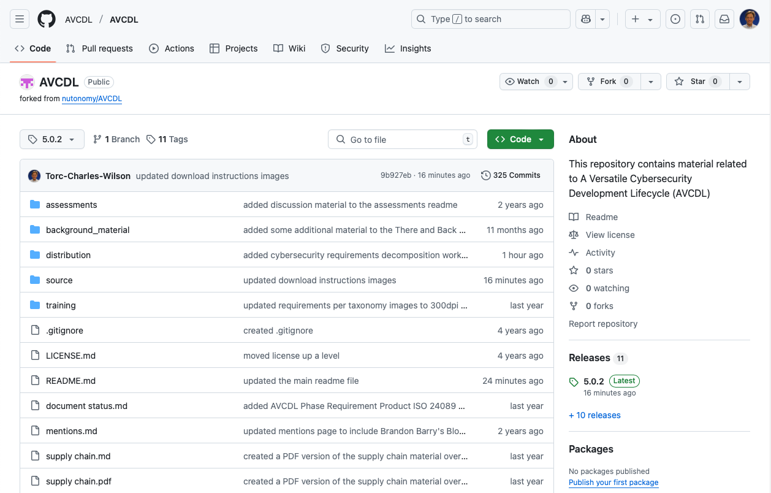
AVCDL on GitHub
https://github.com/AVCDL/AVCDL
Notes:
Script:
All AVCDL materials, both in source and distribution forms, are available on our GitHub site, as shown here.
Because of the size of the repository, it's recommended that you either clone the repository or download a ZIP archive of it, if you're not familiar with using git.
Instructions for downloading a ZIP archive are linked to on the repository’s front page.

Slide 33
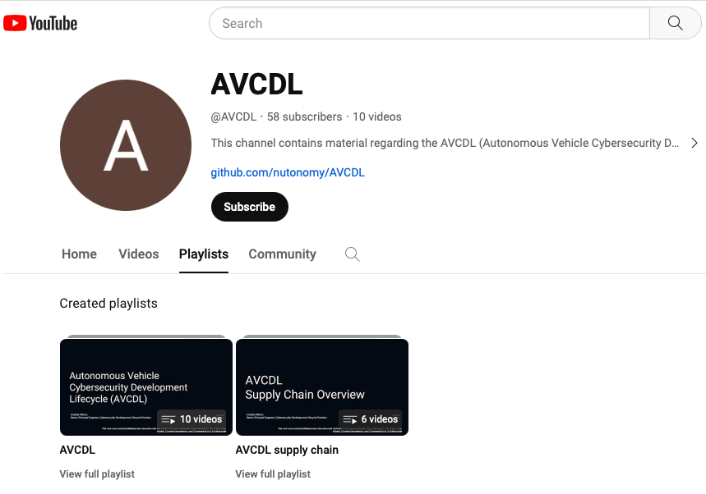
AVCDL on YouTube
https://youtube.com/@AVCDL/playlists
Notes:
Script:
A set of training videos have been created to cover various aspects of the AVCDL that follow the training path found in the AVCDL primary document.
It's important to note that all AVCDL materials except for the introductory blog posts are intended for product cybersecurity engineering practitioners.

Slide 34
Next Steps
Notes:
Script:
The final training in the threat modeling sequence is threat candidate triage.
Once you have completed all the trainings related to threat modeling, you can proceed to one of the other trainings at this level.
These are:
Attack Surface Analysis
Penetration Testing
and
Vulnerability Identification
Additionally, if you’ve completed Secure Coding and its prerequisites you can also proceed to
Static analysis
Dynamic analysis
Fuzz testing
and
Secure Code Review

Slide 35
References
AVCDL (GitHub)
https://github.com/AVCDL/AVCDL
Cybersecurity Engineering Approach (AVCDL secondary document)
Element Cybersecurity Relevancy (AVCDL secondary document)
Security Requirements Taxonomy (AVCDL secondary document)
Threat Modeling – Analysis Procedure (AVCDL tertiary document)
AVCDL threat modeling model template (AVCDL template)
AVCDL threat modeling analysis template (AVCDL template)
Guide to Data-Centric System Threat Modeling
https://csrc.nist.gov/publications/detail/sp/800-154/draft
Notes:
Script:
Here are references to the source material used in the creation of this presentation.
They'll also be included in the video description.
Additionally, this presentation’s source material will be provided on the AVCDL GitHub repository.

